Slide 4
A wide variety of copy formats used to tell a story.

Slide 5
Question & Answer
Step by Step
How To
Fast Facts
Narrative
Profiles
Timeline
Quote Collection
Maps
Conversation
Recipe
Advice
Calendar
Checklist
Tag the Date
Chronology

Slide 6
A question and answer format of two students replaces the typical copy format.

Slide 7
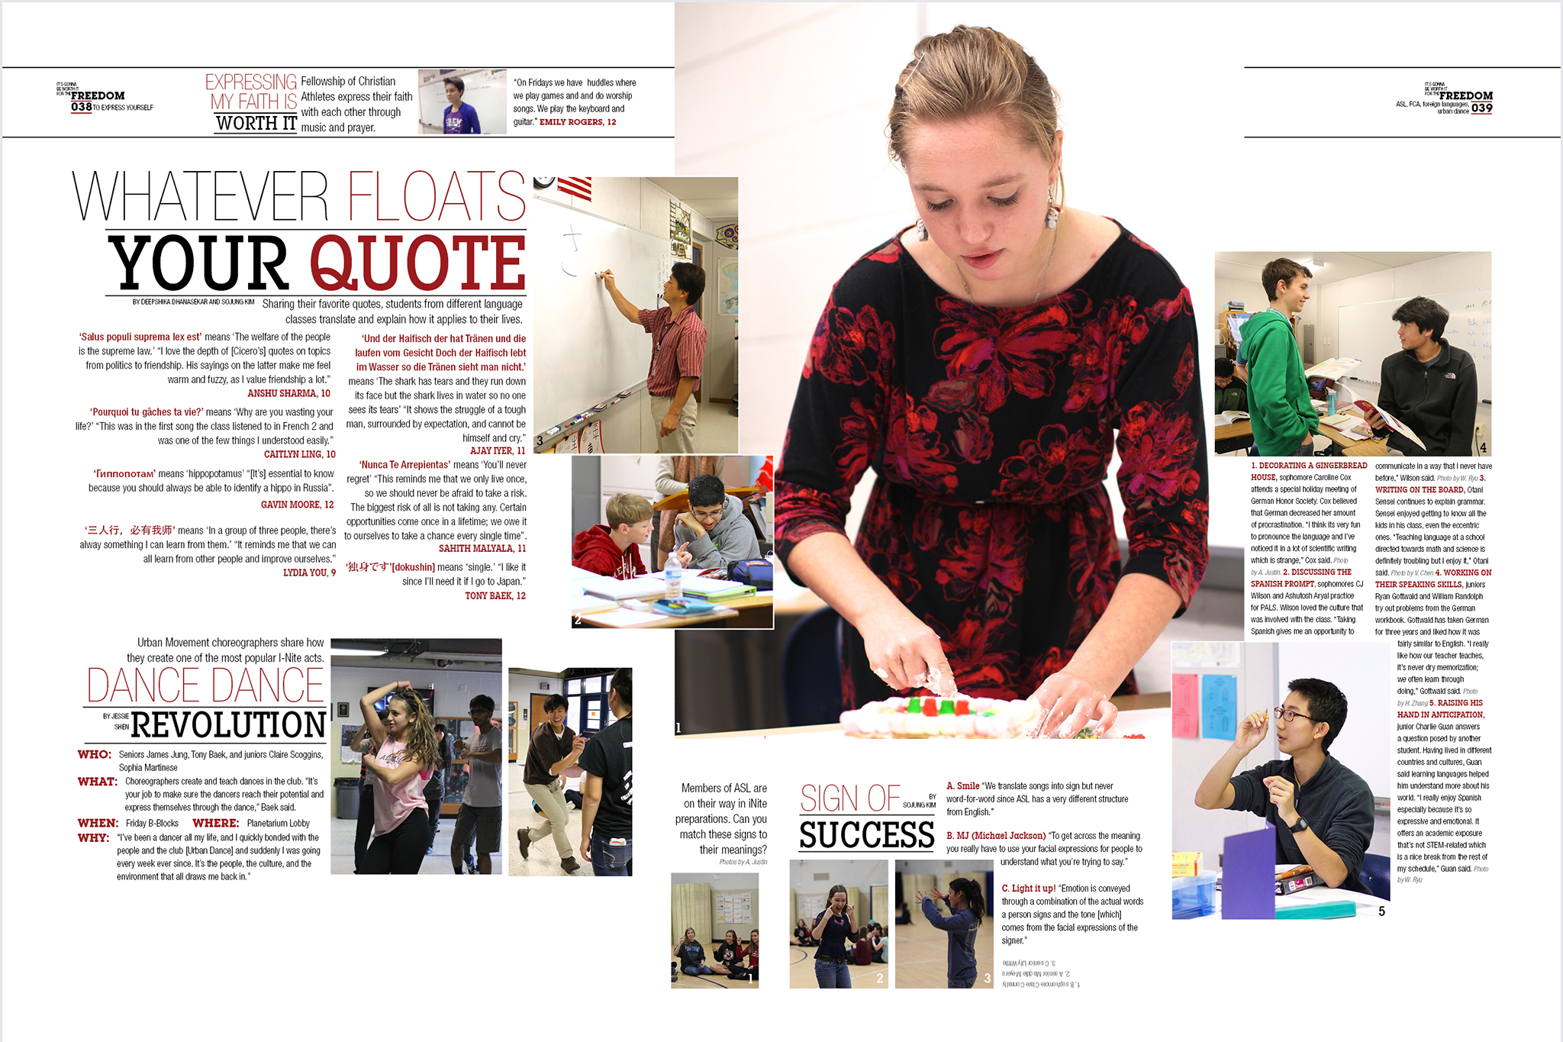
A question and answer format replaces the typical copy format.

Slide 8
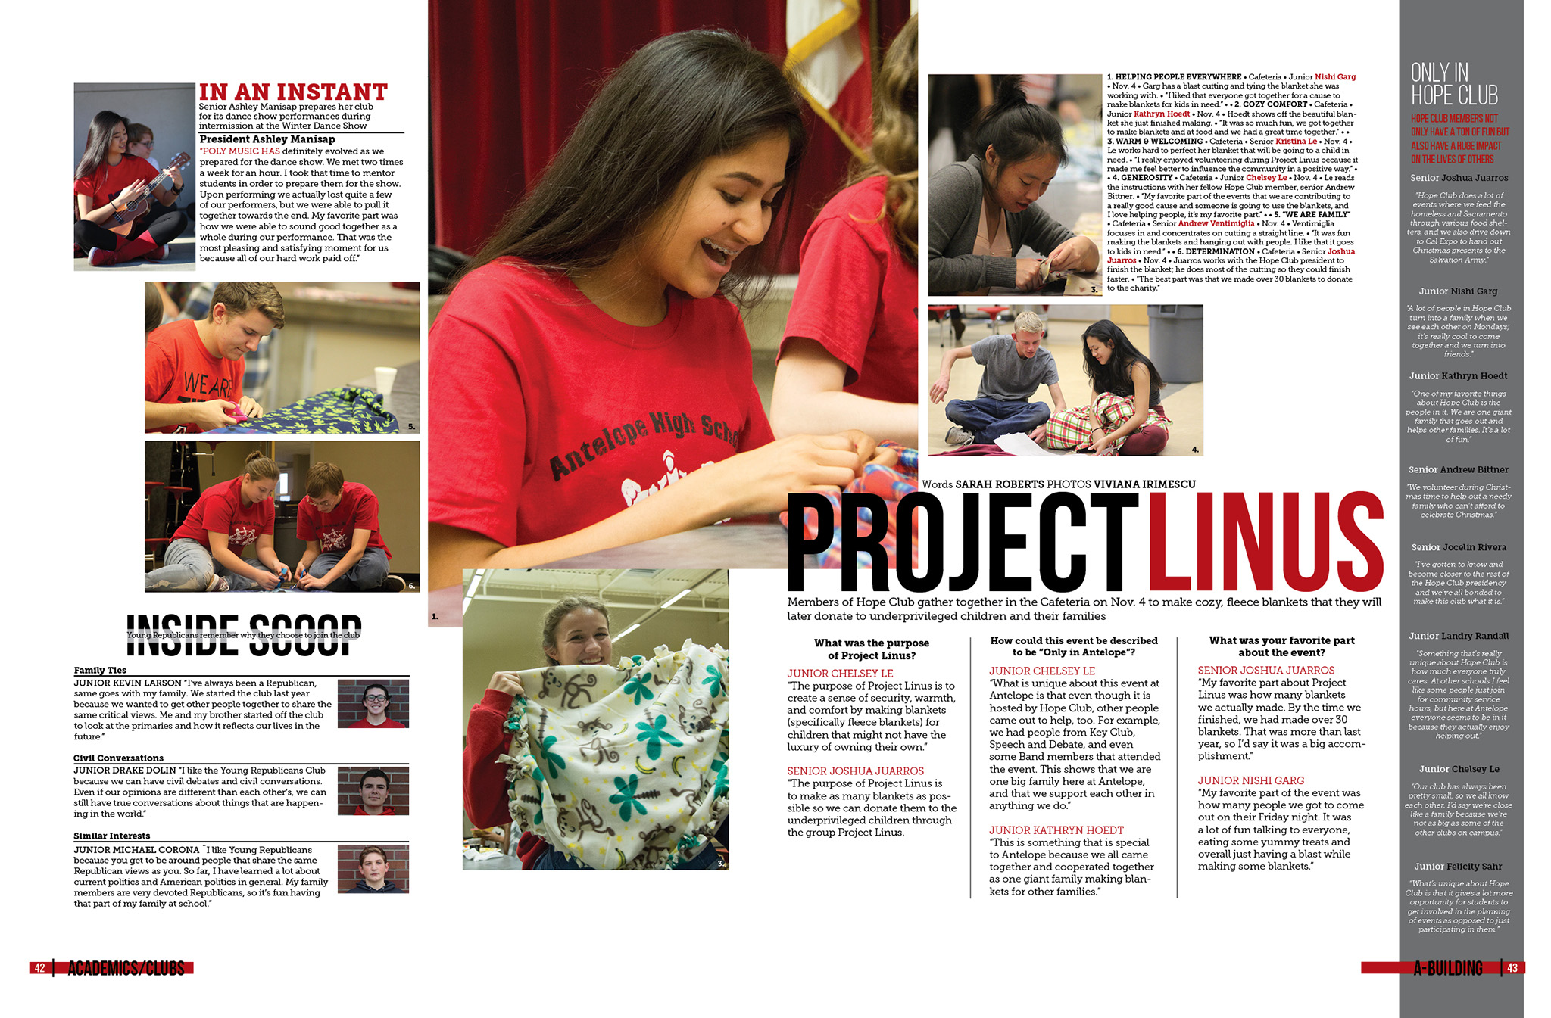
A question and answer format replaces the typical copy format. This uses three distinct questions.

Slide 9
Four copy blocks demonstrate the four steps necessary to make heart boxes in woodshop.

Slide 10
On the side of the layout, blocks of color demonstrate how the yearbook was made by teams.

Slide 11
Copy block in the middle of the spread, first tells you the facts about what you saw at the tennis match.
The second block tells you what you didn’t see.

Slide 12
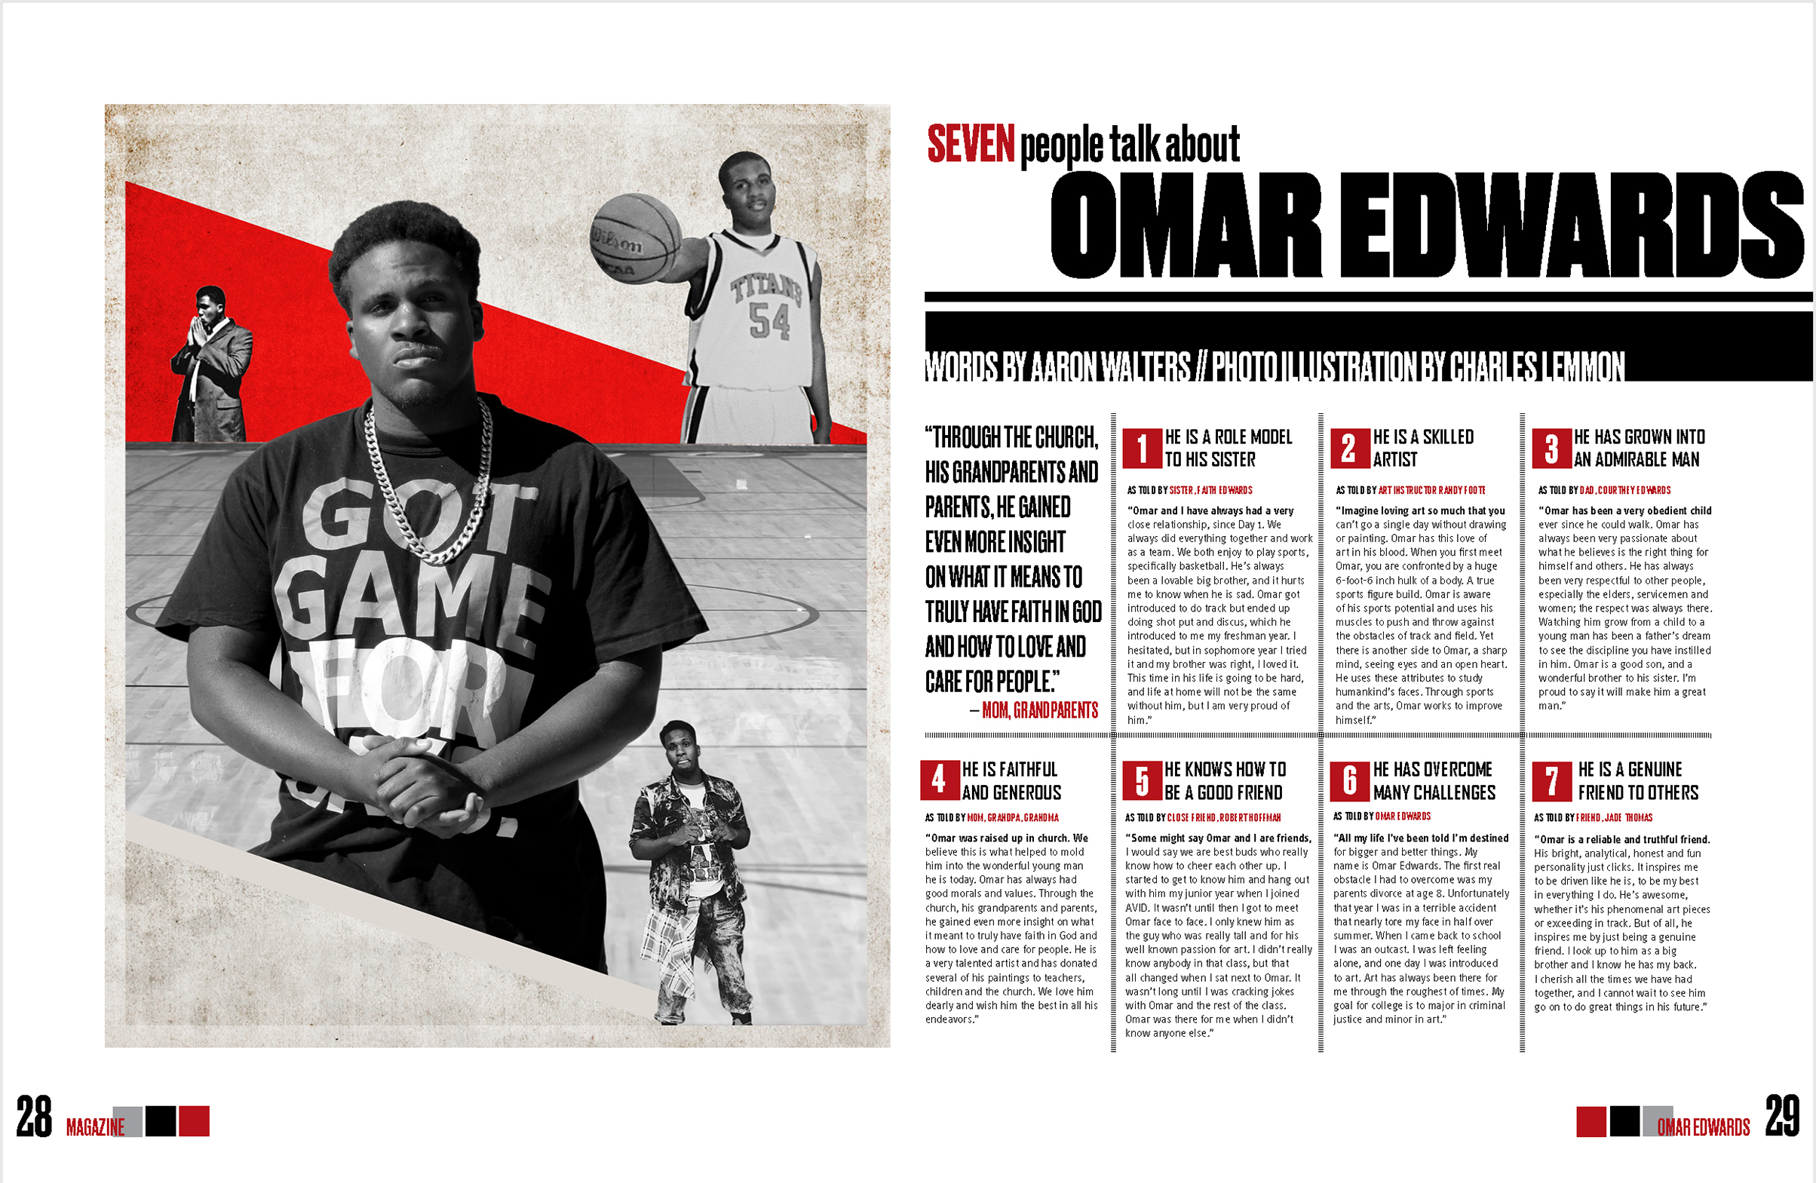
Seven people write a narrative about Omar.

Slide 13
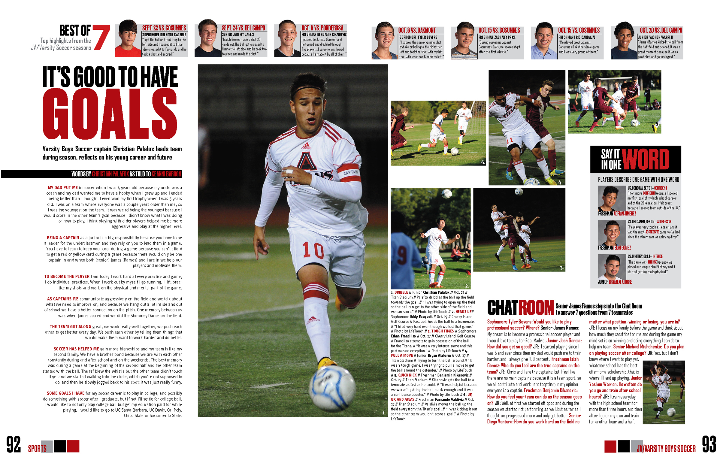
Soccer captain writes about being captain and the season.

Slide 14
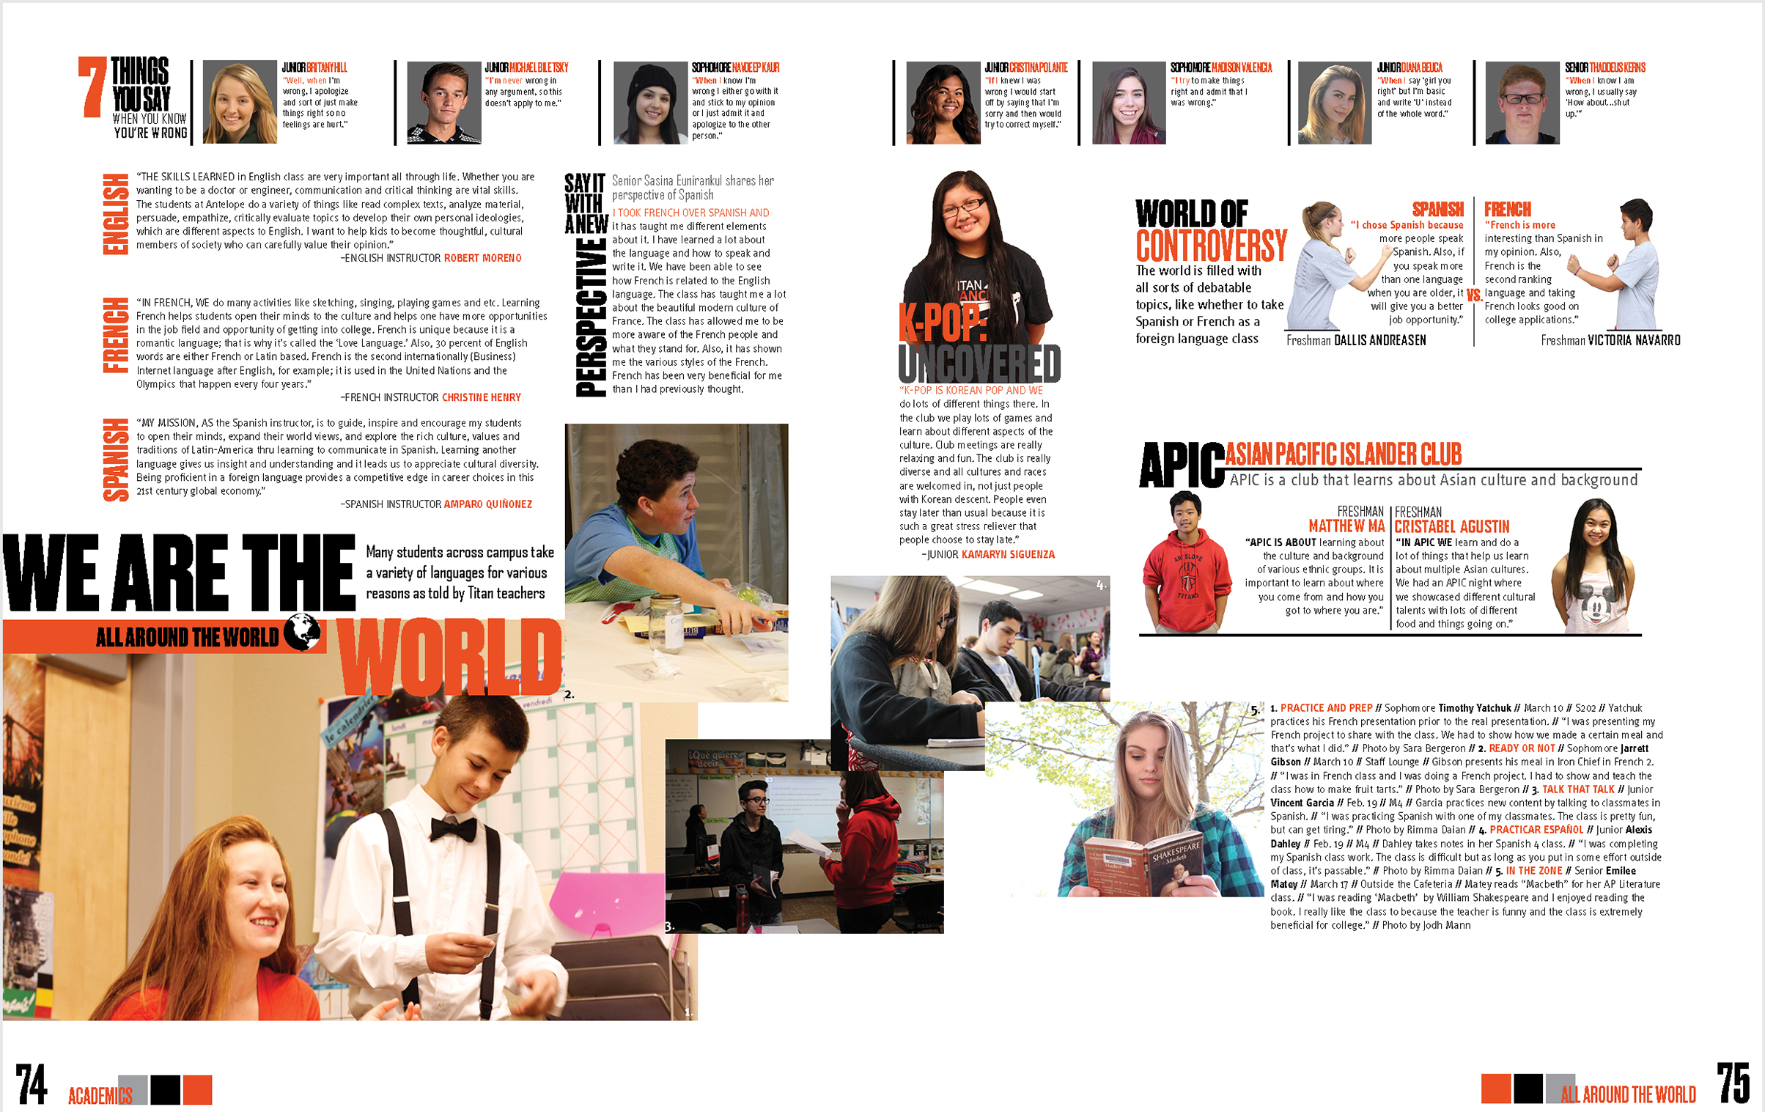
First person narratives tell different stories about three different academic subjects.

Slide 15
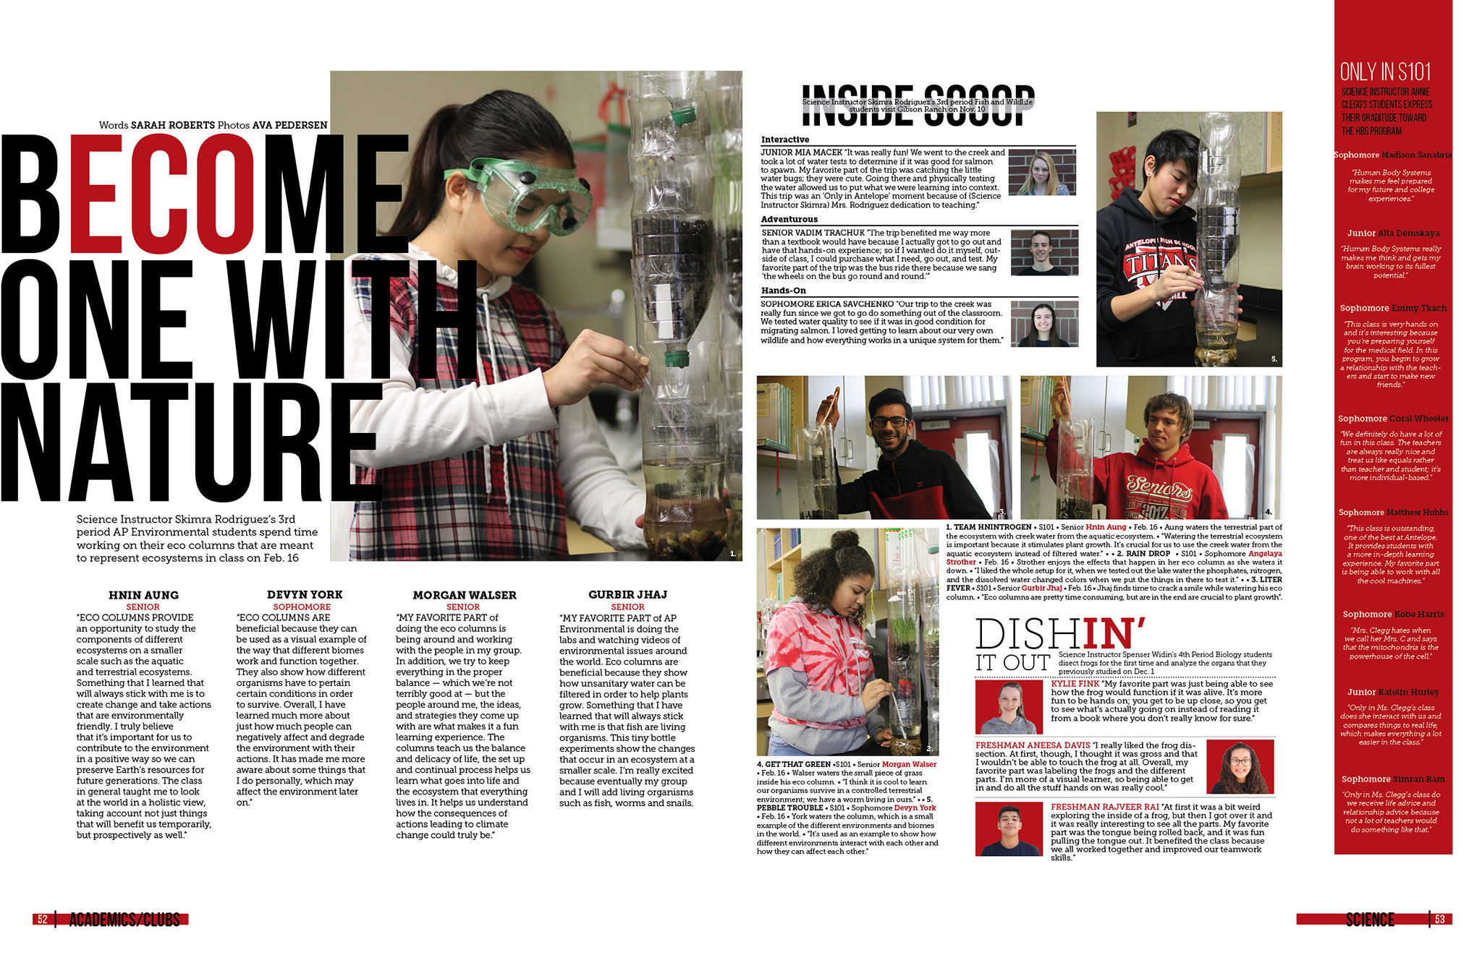
Four students define what eco-columns mean by using a quote.

Slide 16
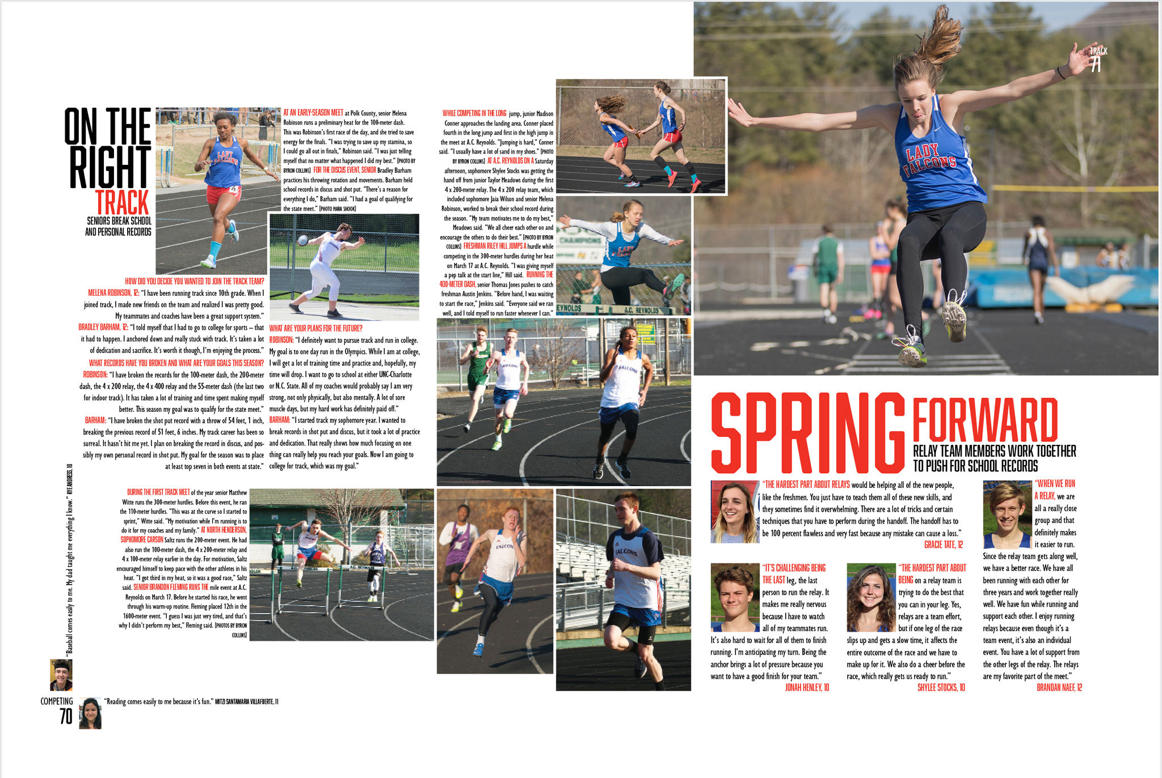
Four students tell about being on a relay team together.

Slide 17
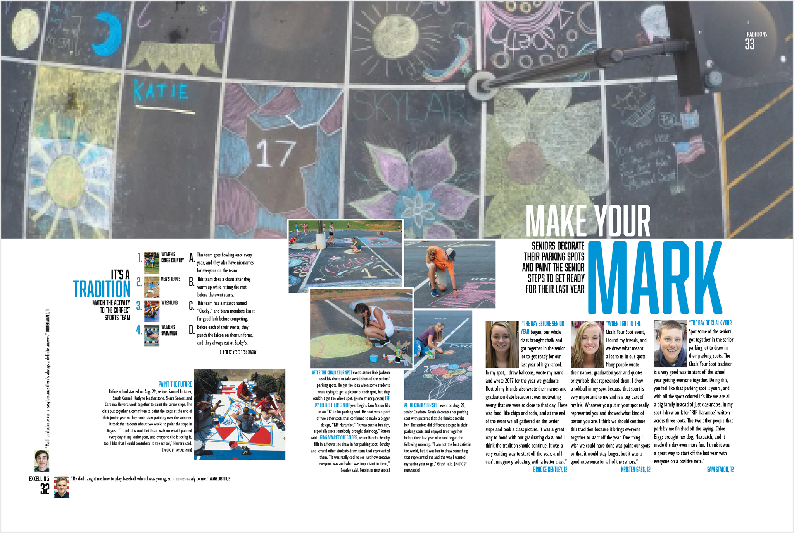
Three students tell about decorating their parking space.

Slide 18
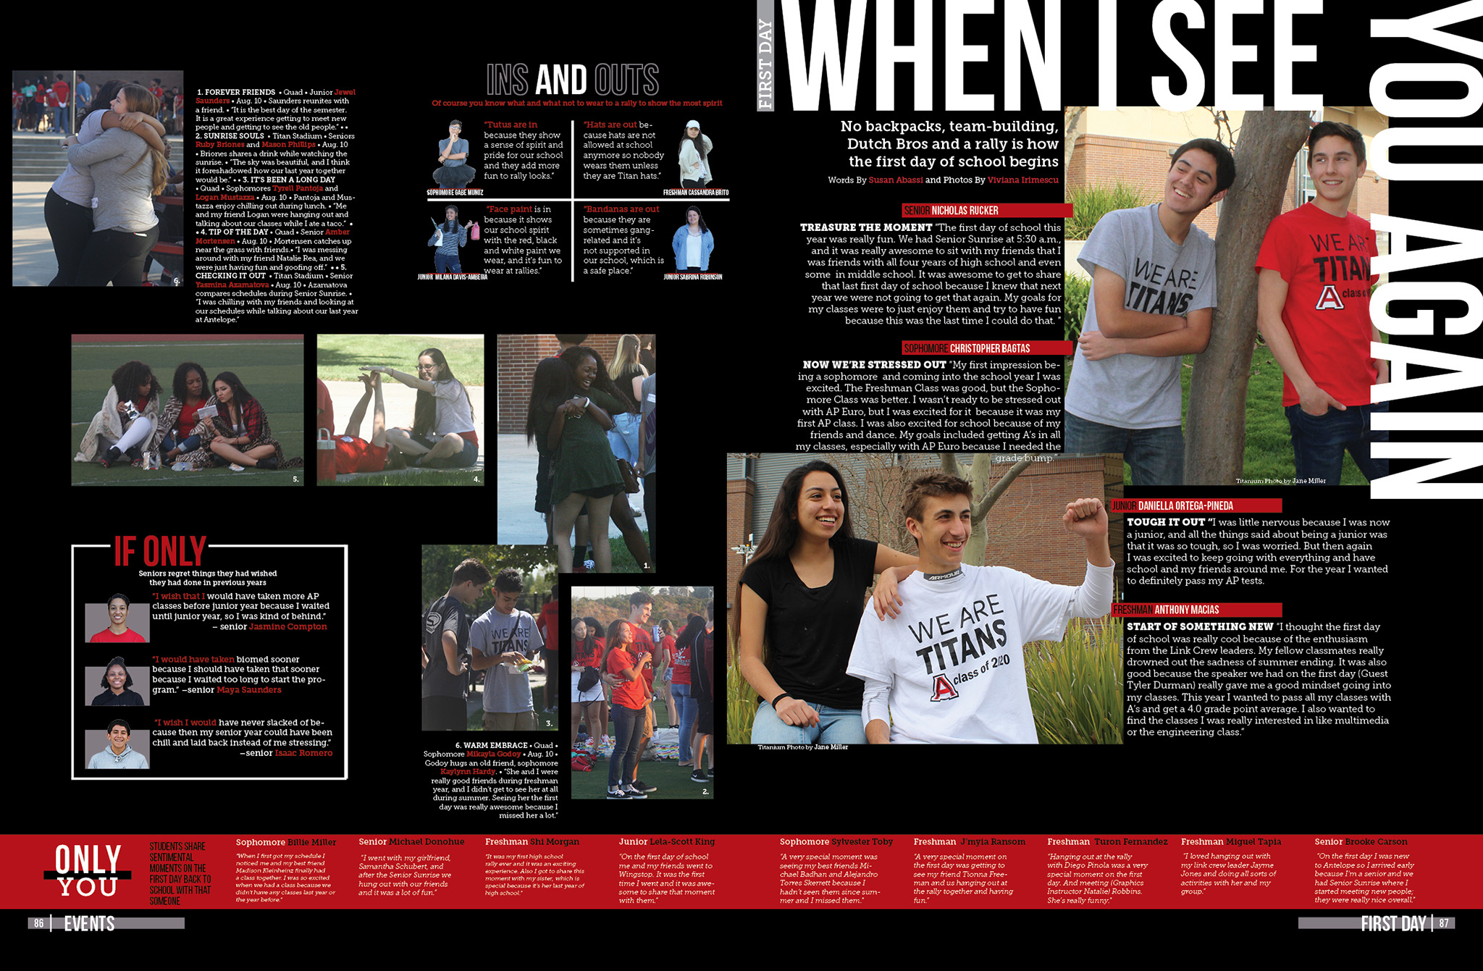
Four students describe their experience for the first day of school.

Slide 19
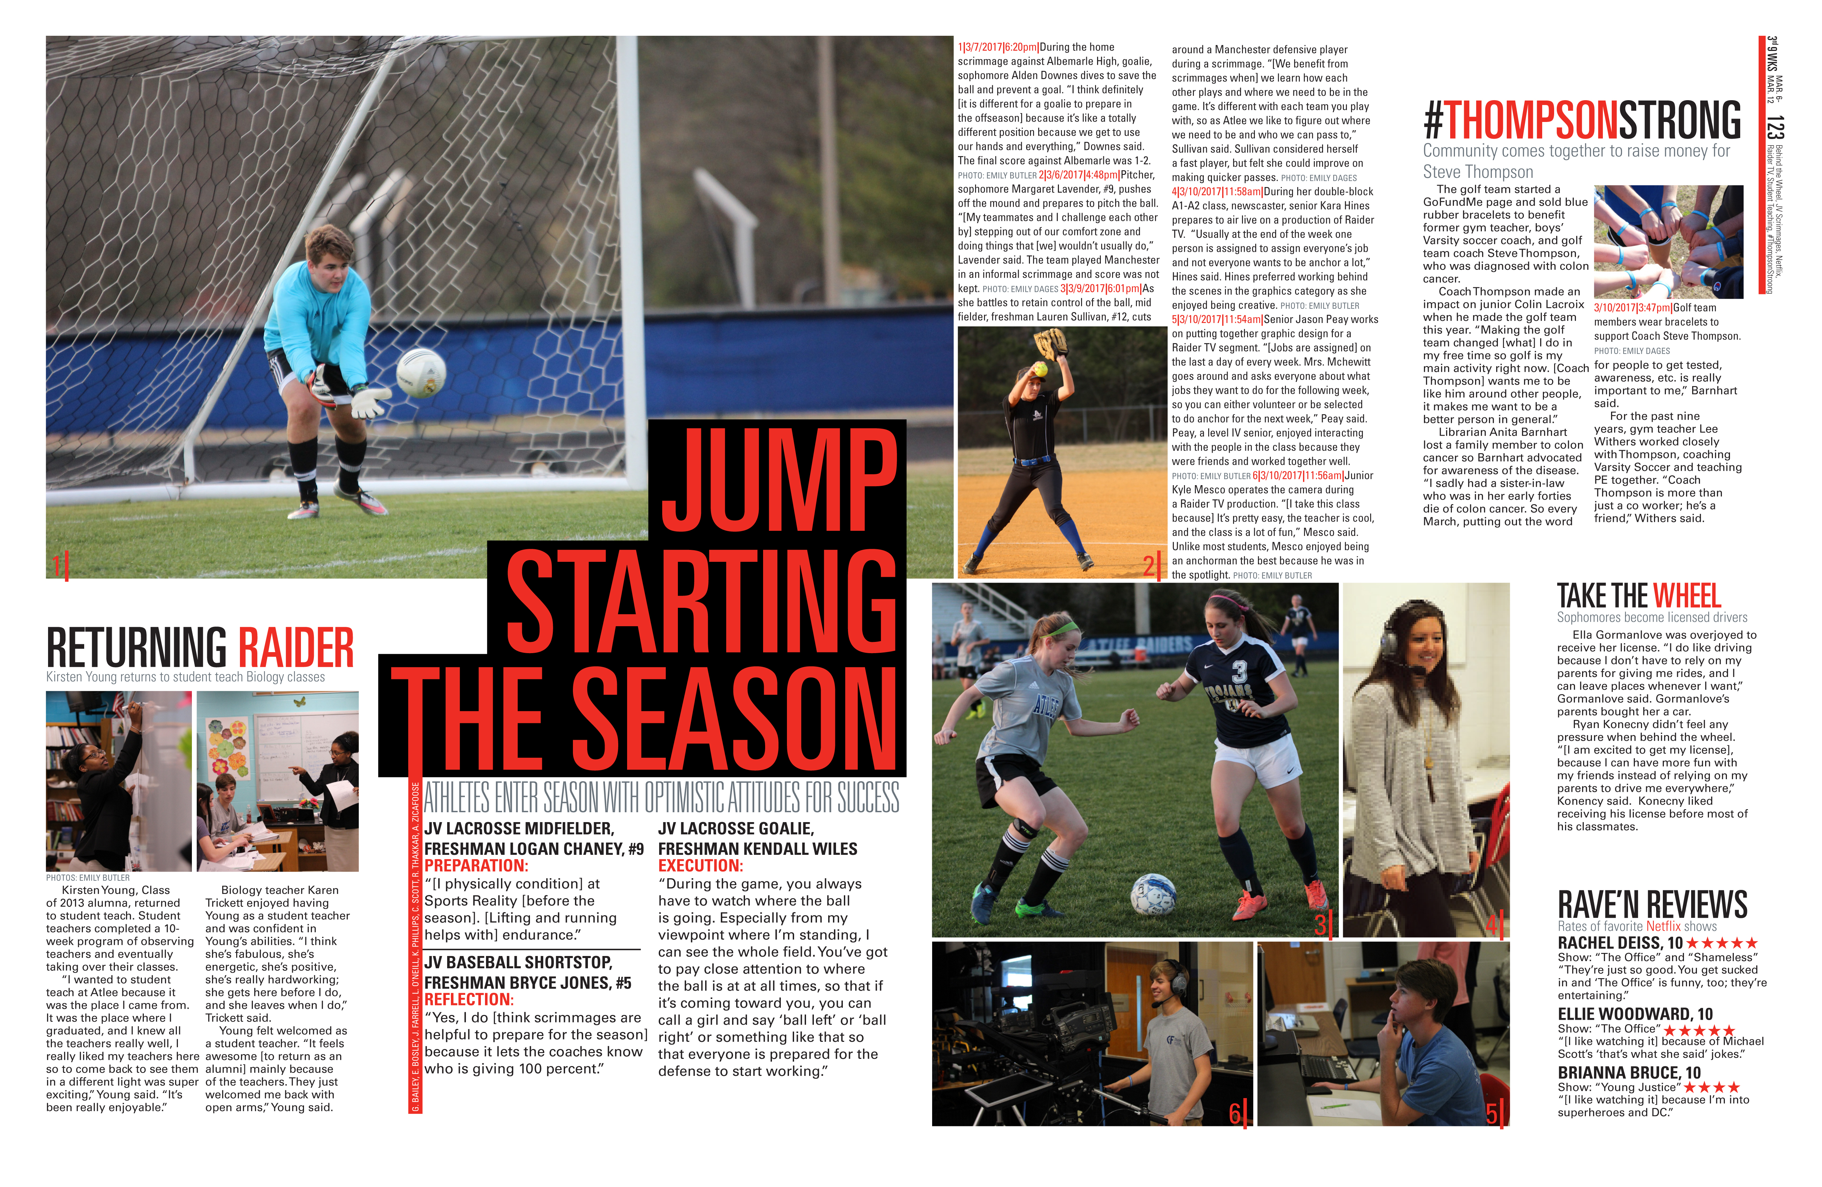
Three lacrosse players speak on preparation, reflection, and execution.

Slide 20
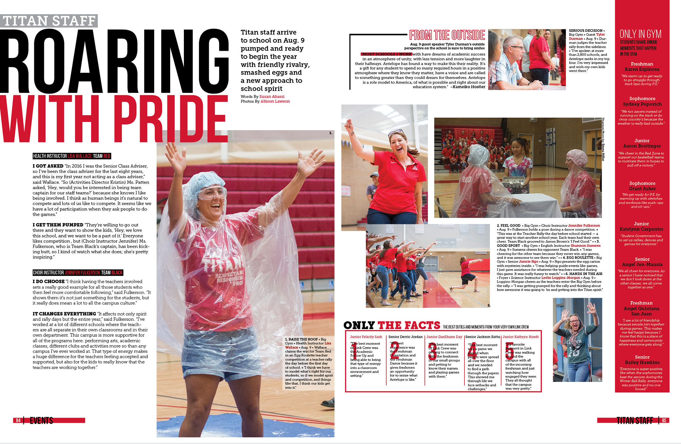
Two team leaders describe leading their team to promote school spirit.

Slide 21
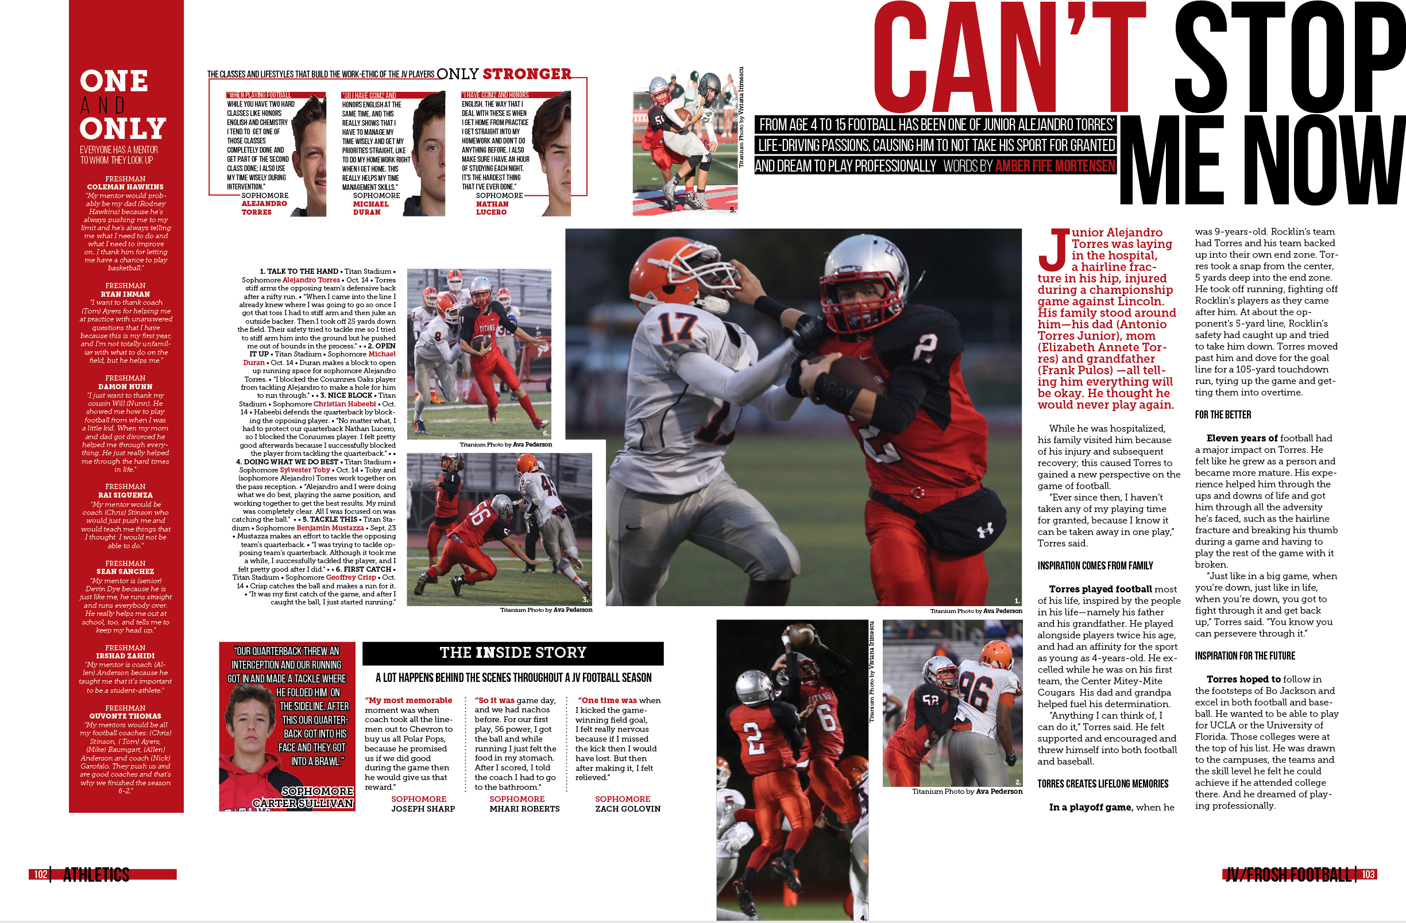
Profile of Alejandro Torres who was injured and in the hospital

Slide 22
Copy is written with quotes from club leaders.

Slide 23
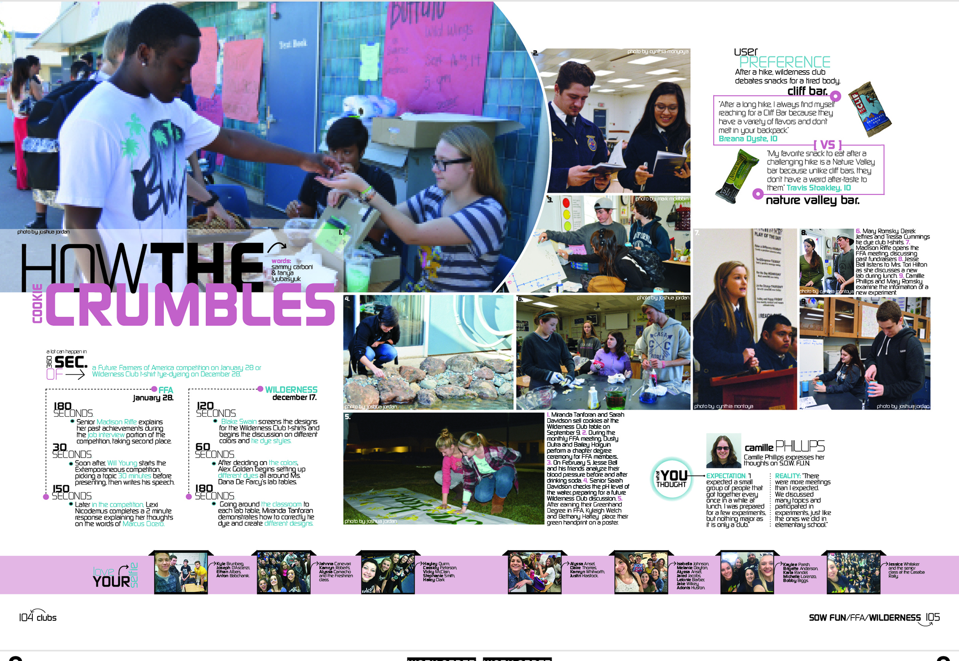
Timeline of two different clubs: FFA & Wilderness replace the traditional copy block.

Slide 24
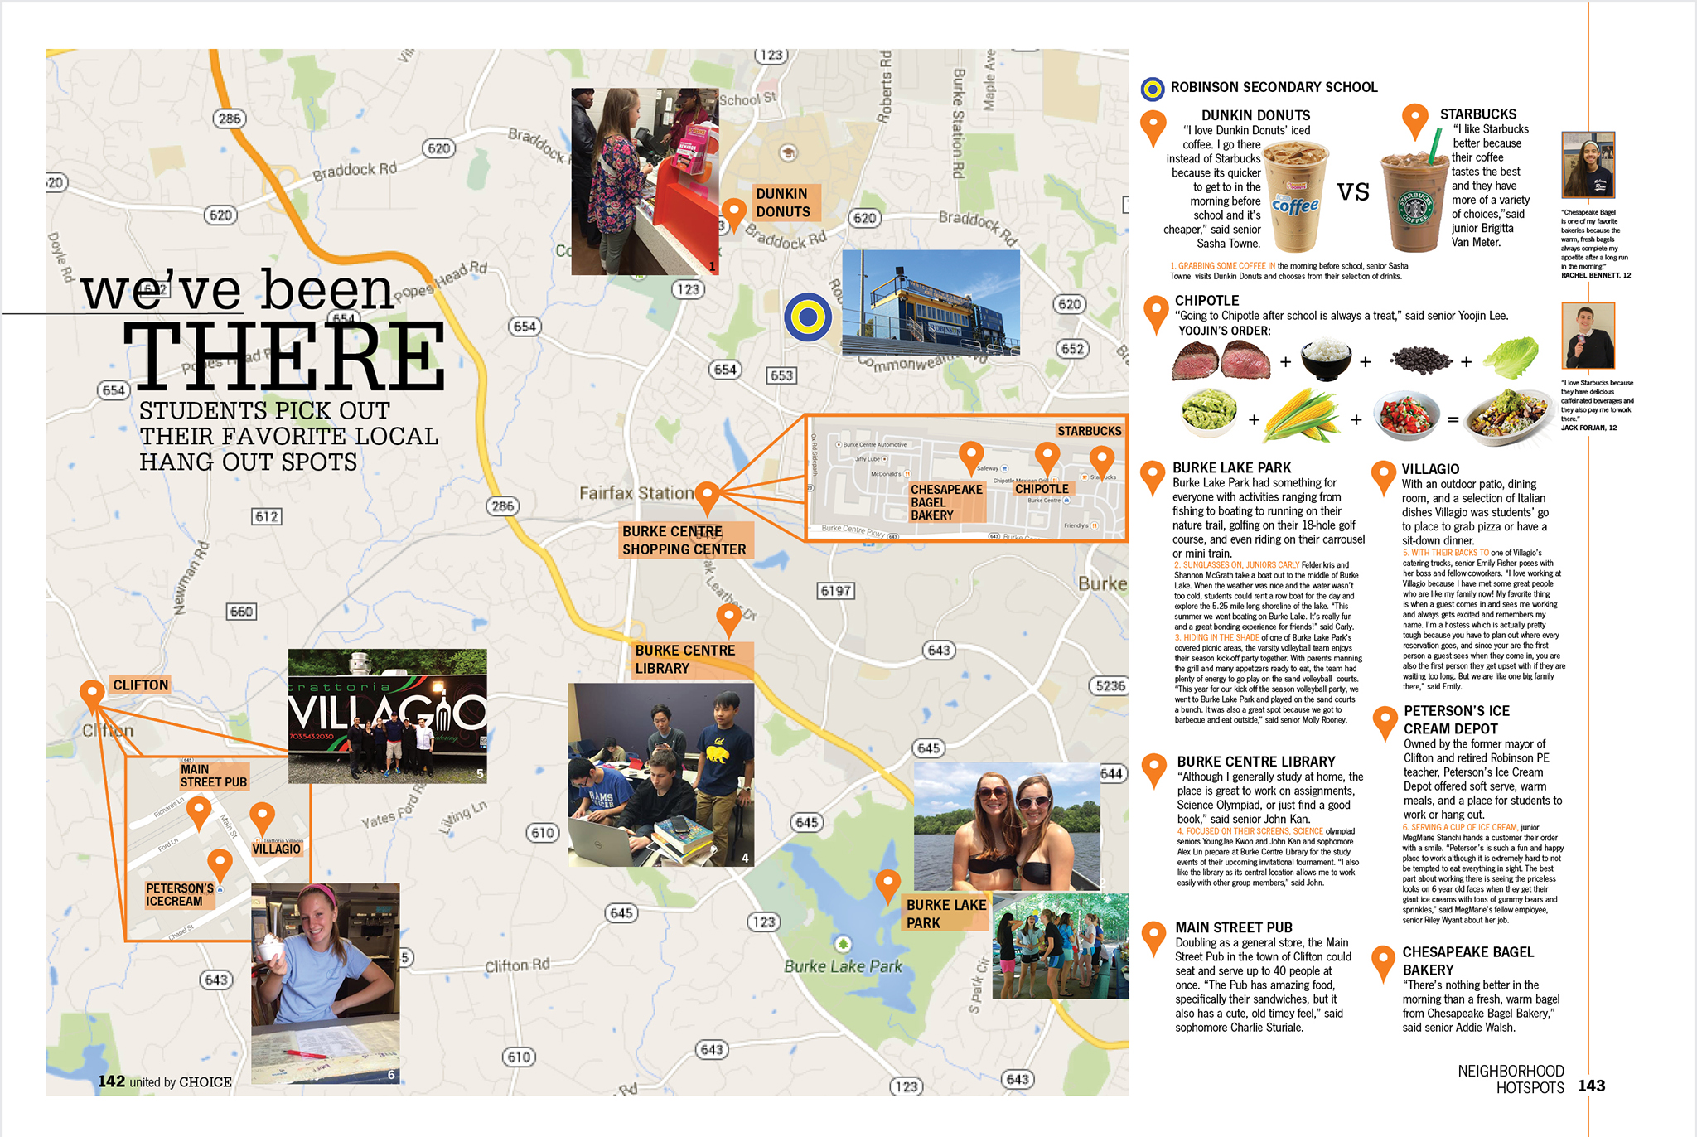
Map provides the graphic for the page and copy covers items on the map.

Slide 25
Tell the story from the transcript of a conversation.
– provided by Erinn Harris and Meghan Percival

Slide 26
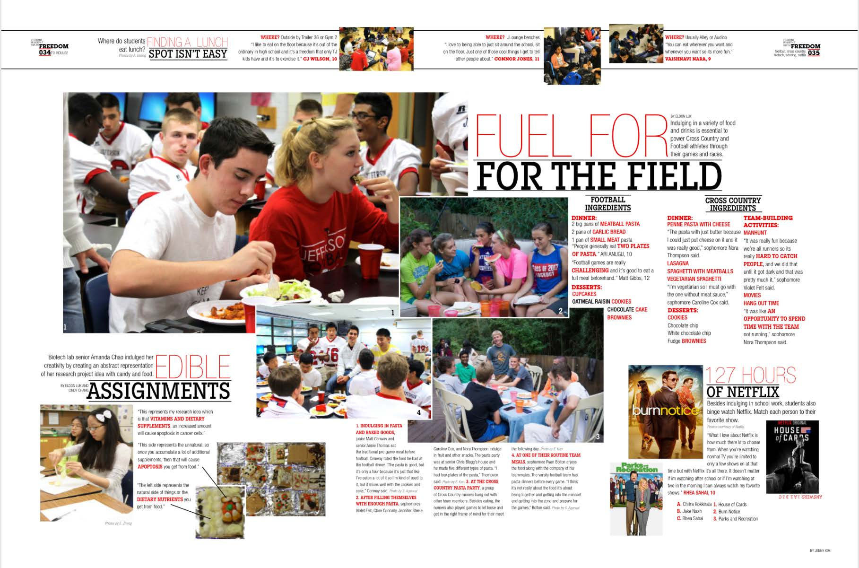
Football and cross country ingredients. – provided by Erinn Harris and Meghan Percival

Slide 27
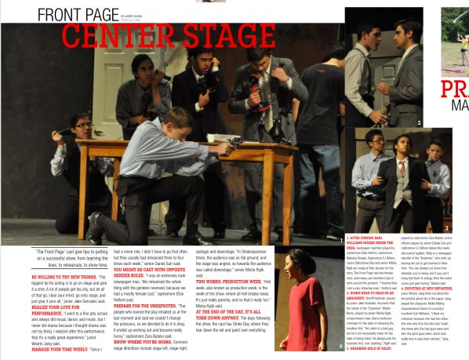
The cast of the play give tips to putting on a successful show. – provided by Erinn Harris and Meghan Percival

Slide 28
If you aren’t covering chronologically, a calendar can cover many activities.
– provided by Erinn Harris and Meghan Percival

Slide 29
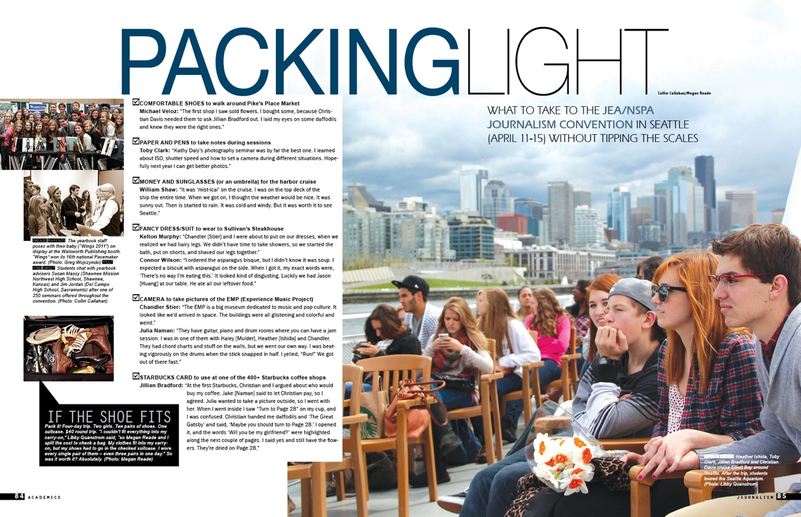
Checklist of what to take on a school trip and quotes about those items.
– provided by Erinn Harris and Meghan Percival

Slide 30
For copy, use the day of the week or the date to drive coverage.

Slide 31
Traditional copy written with small subheads in chronological order of the event.
On the field, it’s showtime, in the moment, the aftermath

Slide 32
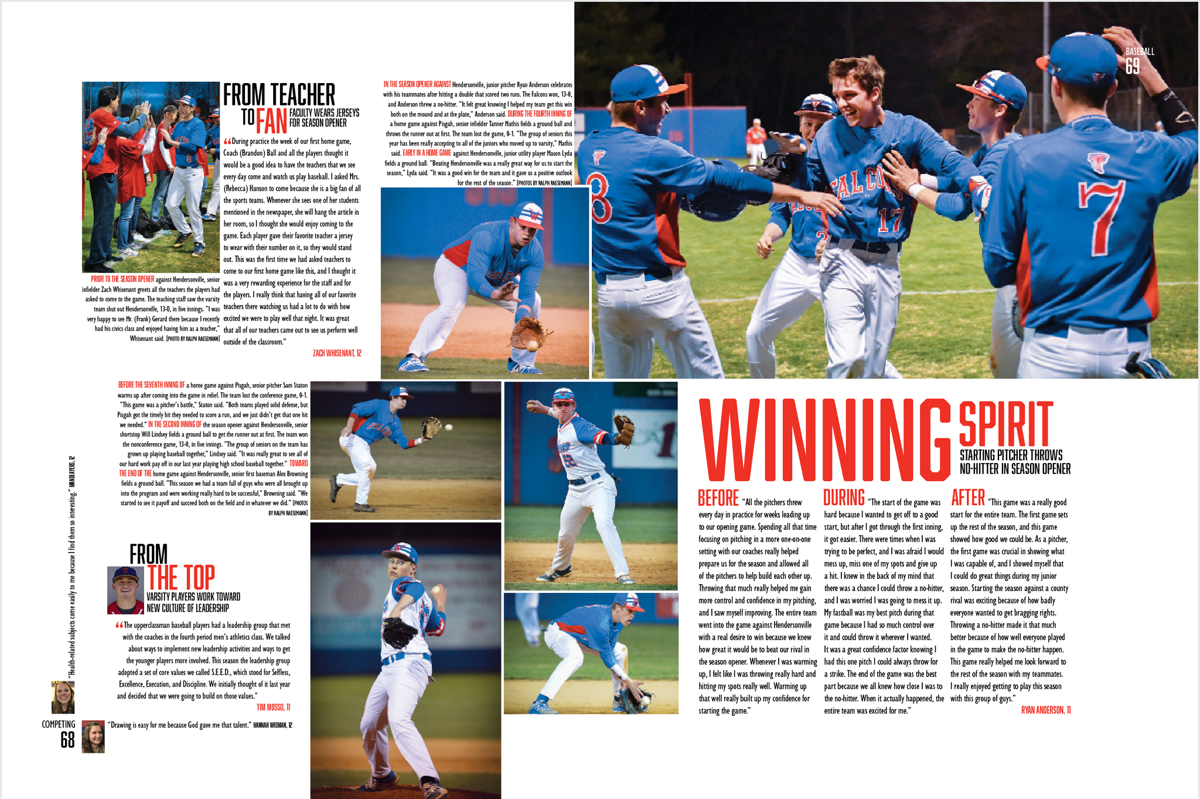
Copy about a no-hitter game: before, during and after.

Slide 33
Fast Fact Box
He Said/She Said
List
Ratings
Map
Glossary
Quiz
Checklist
Biography Box

Slide 34
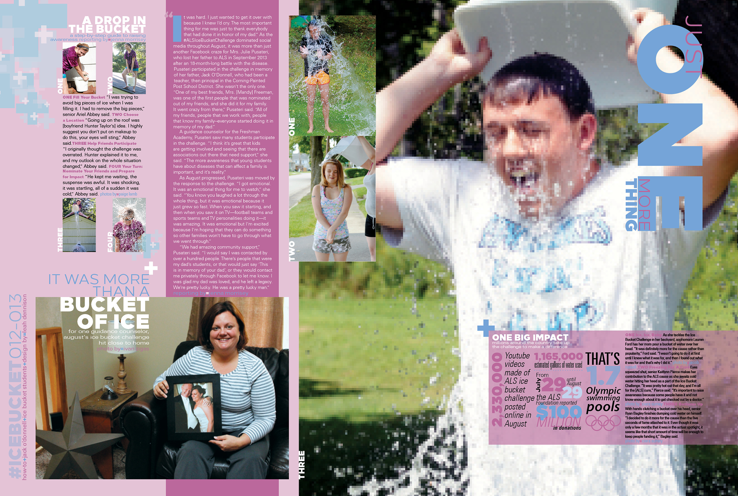
Above right He Said/She Said: Two students share their experiences.

Slide 35
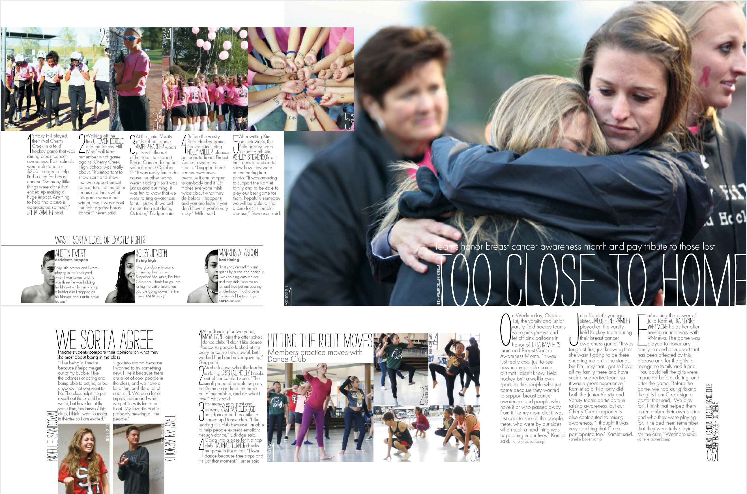
Above left He Said/She Said: Two students compare their opinions.

Slide 36
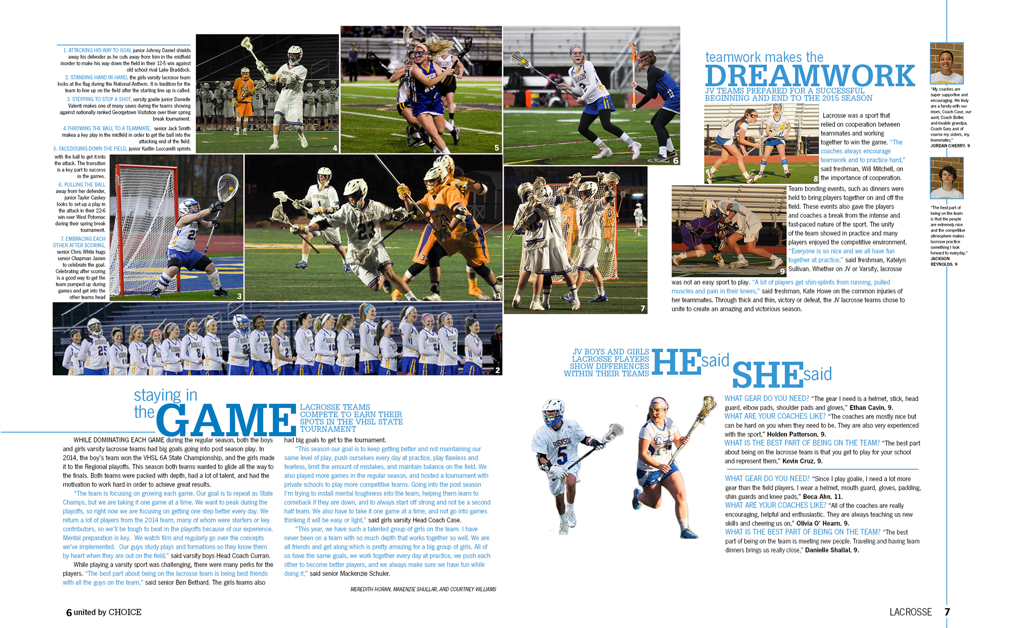
Above right He Said/She Said: Two students share their experiences.

Slide 37
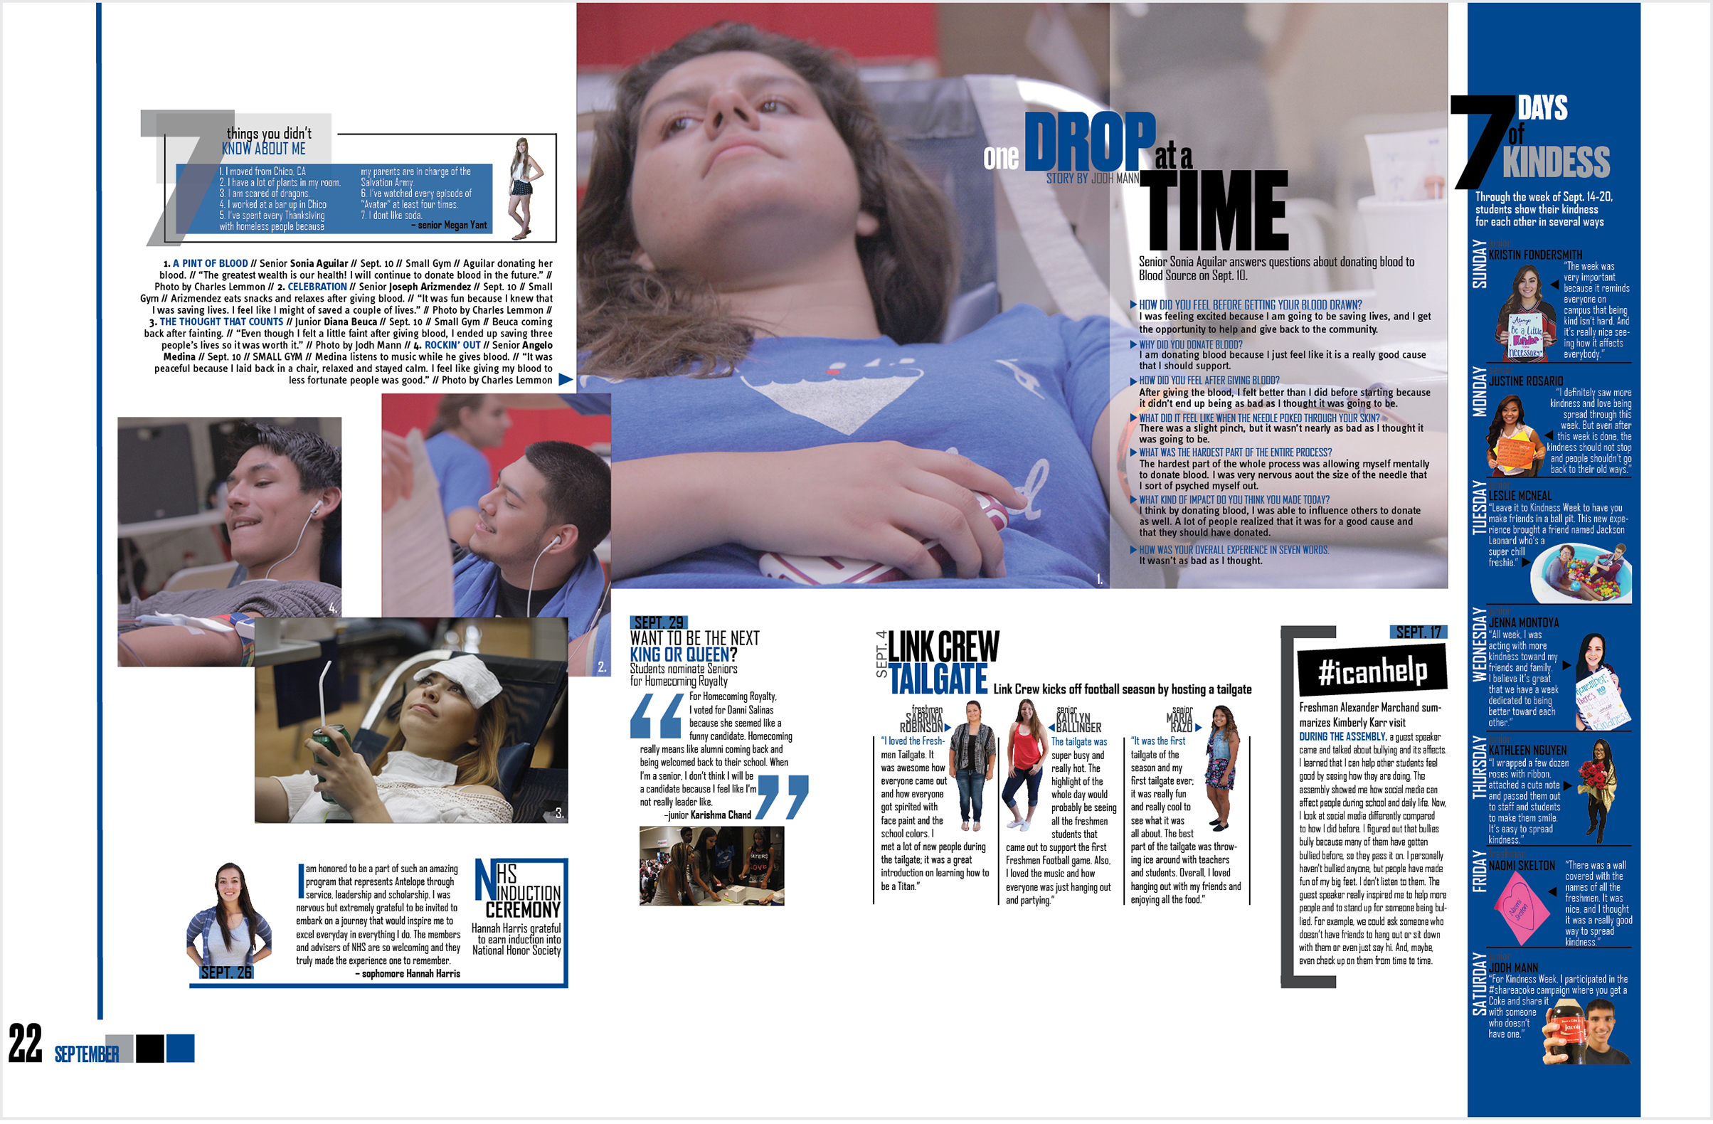
Top left: Seven things that the reader doesn’t know about this student.

Slide 38
Far right: Six students rate their top 5 books.

Slide 39
Top middle: A map shows where this student has fished.

Slide 40
Far left: Definitions of words used in social media.

Slide 41
Bottom right: Conference challenge asks students what part of the story was true.

Slide 42
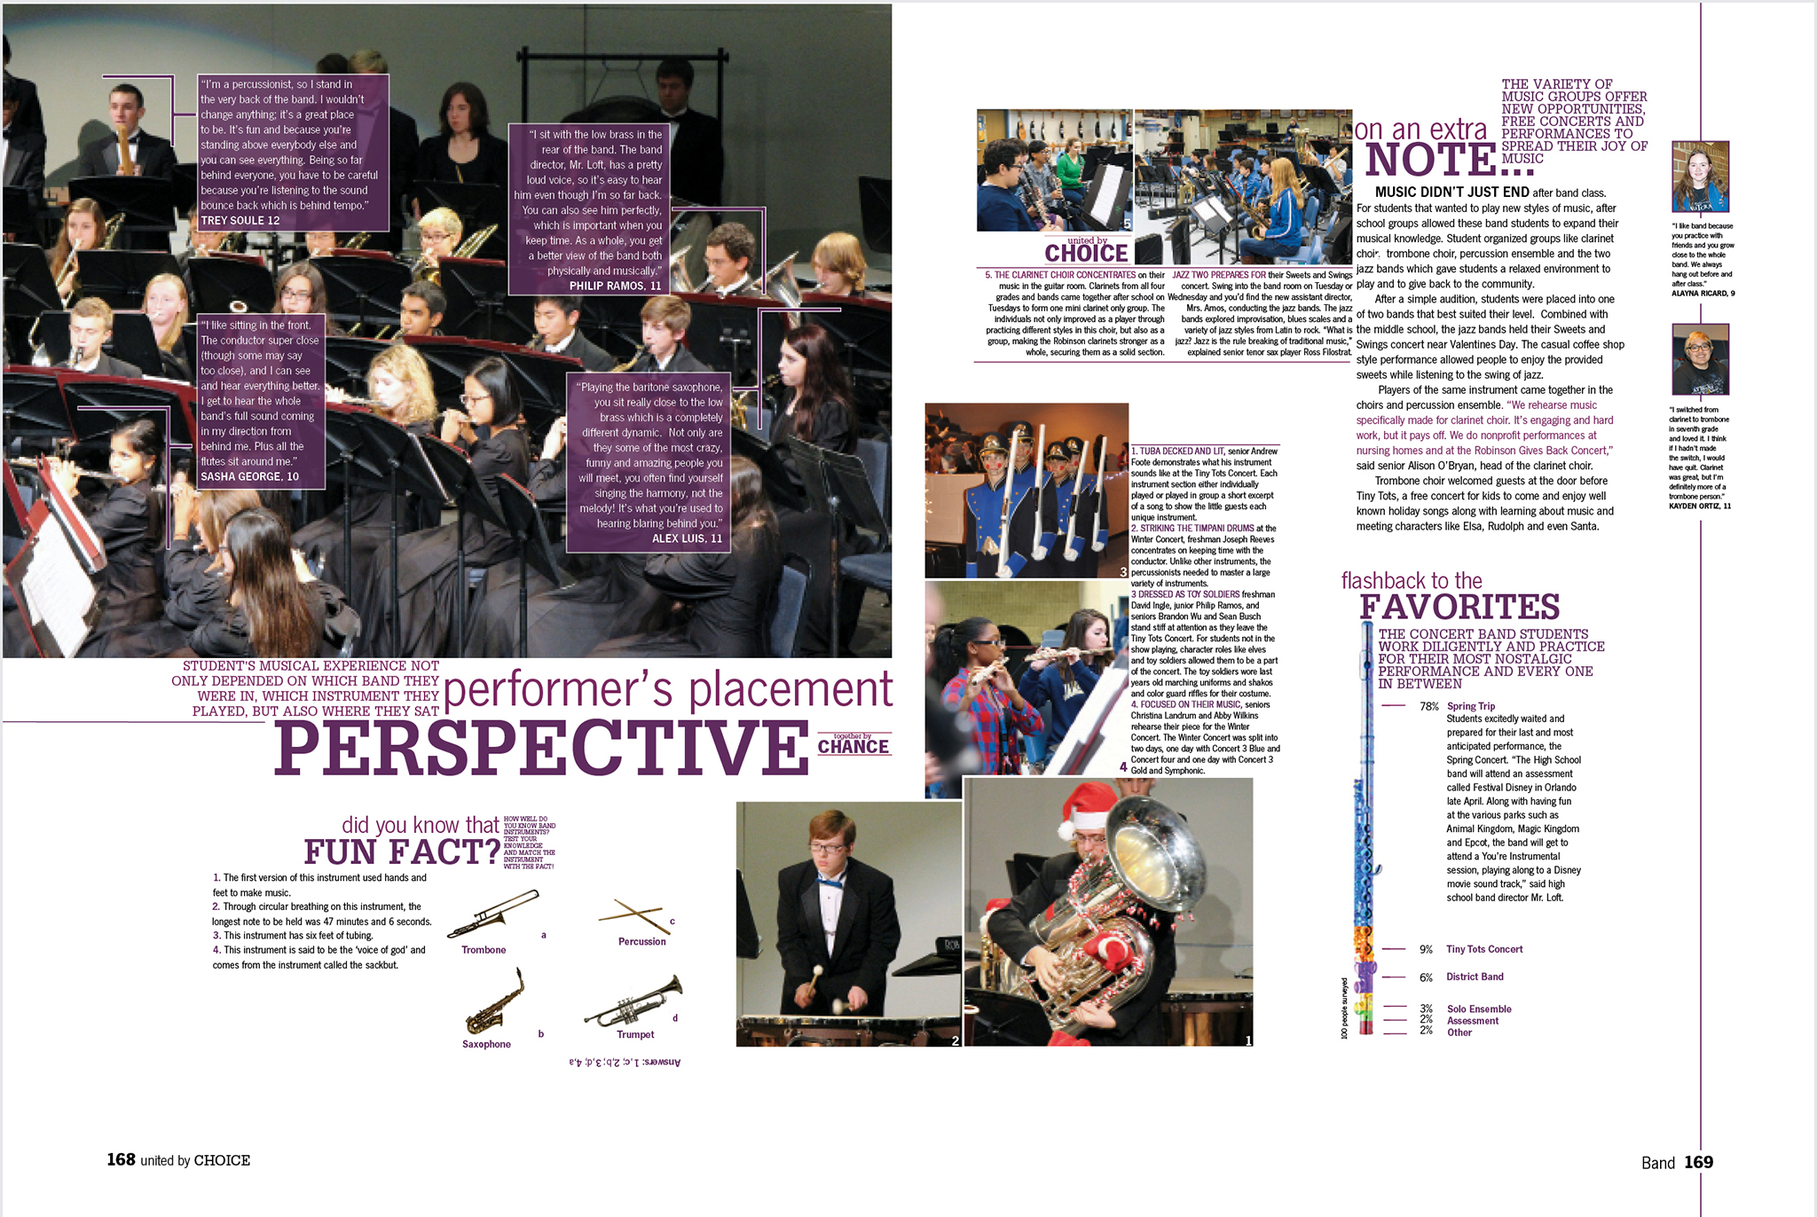
Bottom left: Match the instrument to the fun fact.

Slide 43
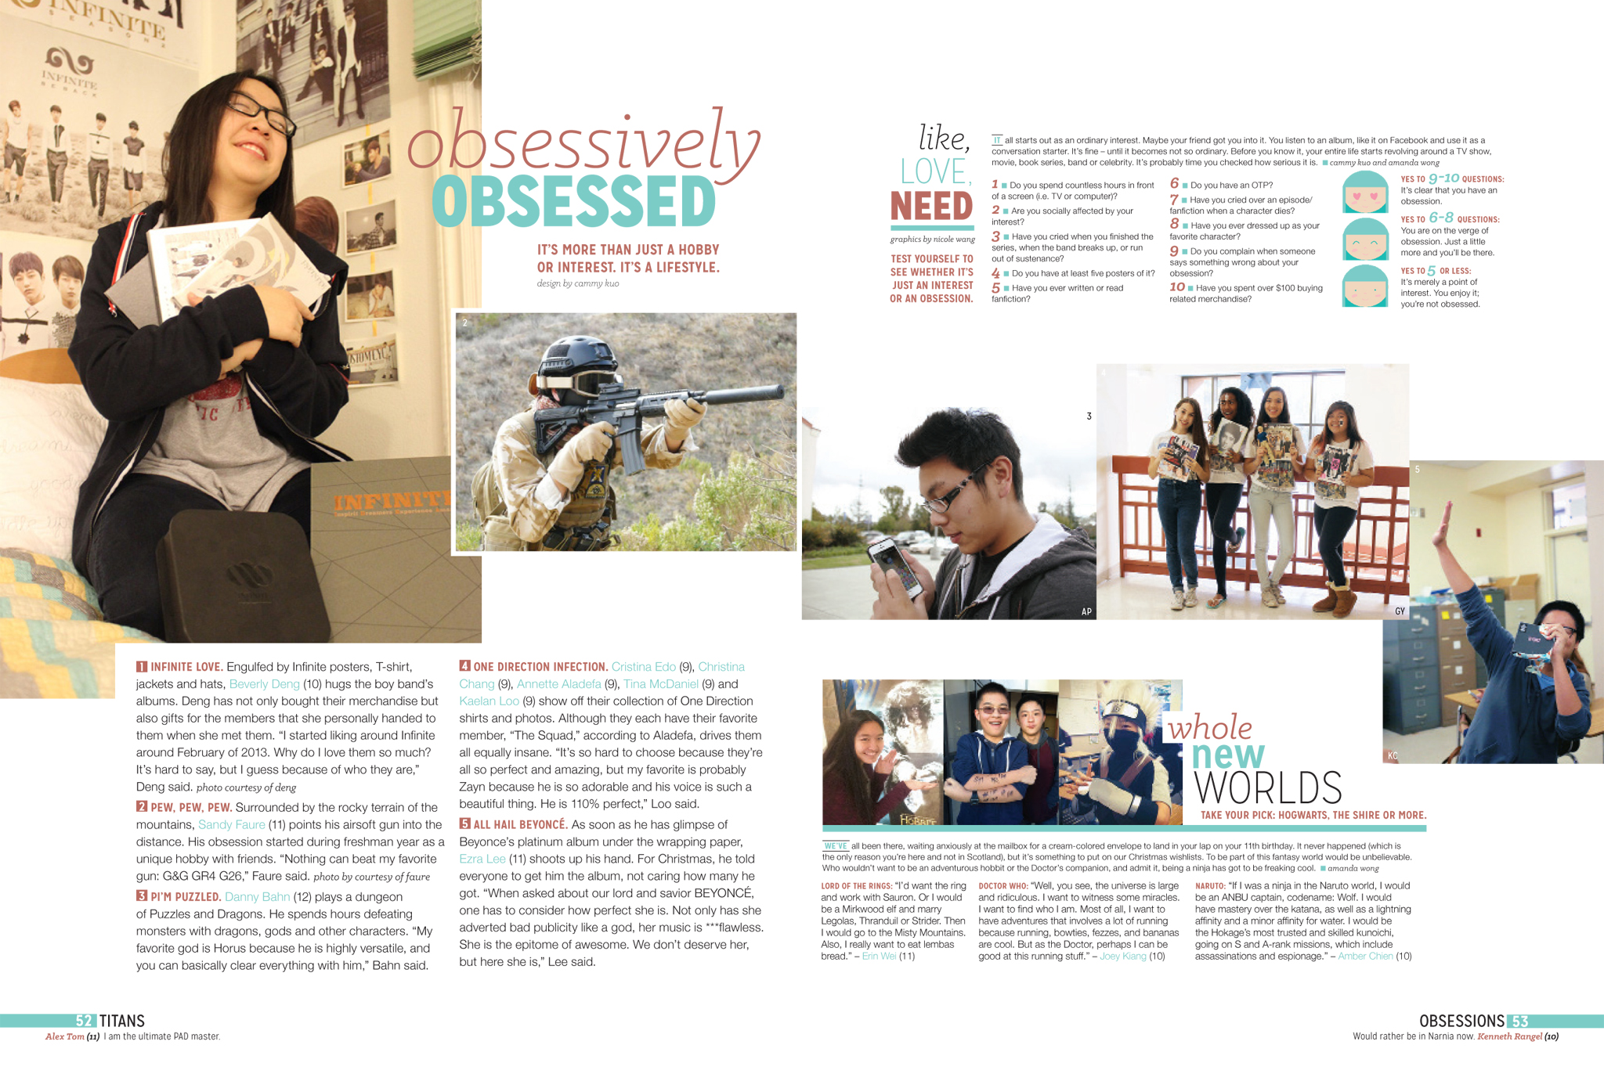
Top right, like, LOVE, NEED: Take a quiz to see if you have an obsession.

Slide 44
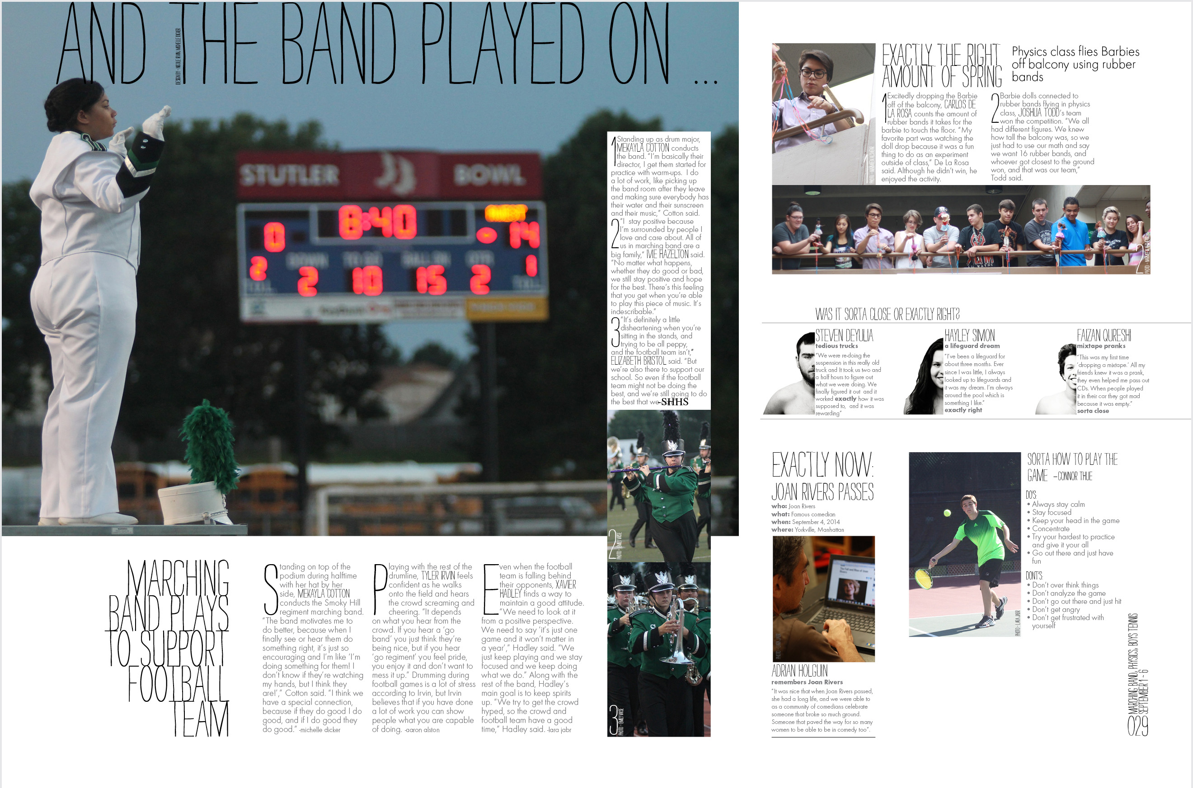
Bottom right: A checklist of things to do and not to do when playing tennis.

Slide 45
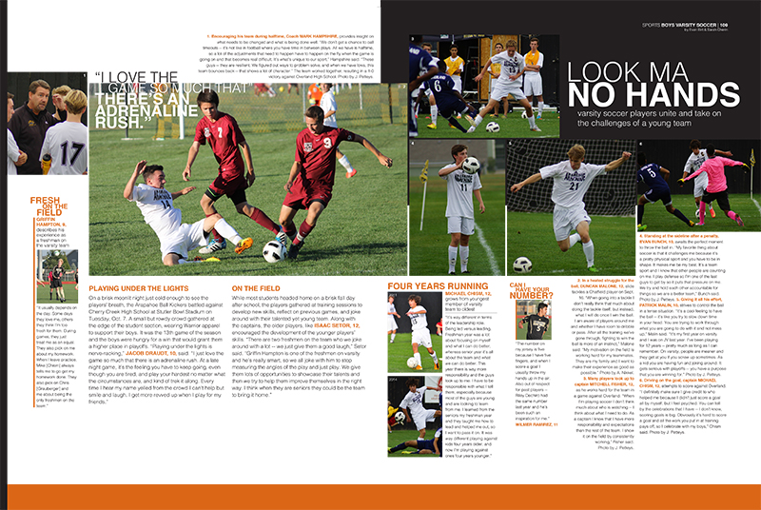
Far left: Biography box of team captain

Slide 46
Polls
Charts
Diachart
Infographics

Slide 47
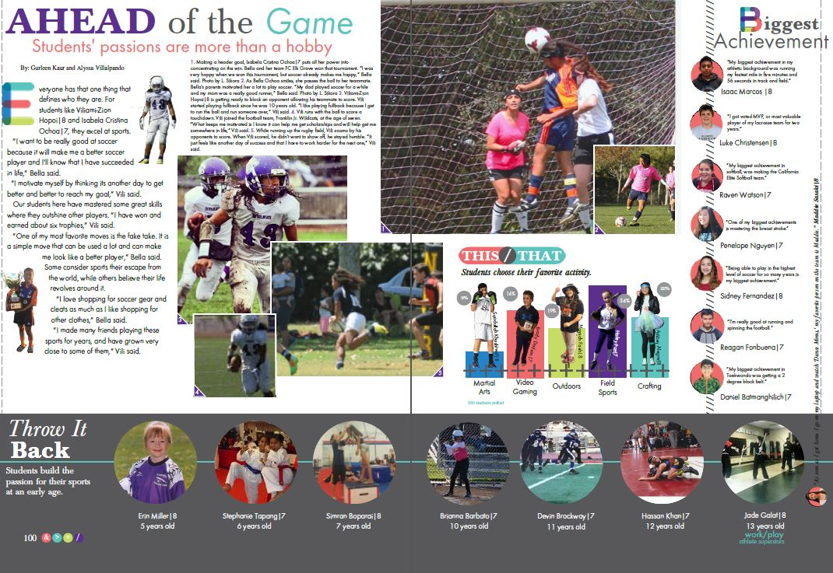
Middle left, This/That: Poll on reader’s favorite activities

Slide 48
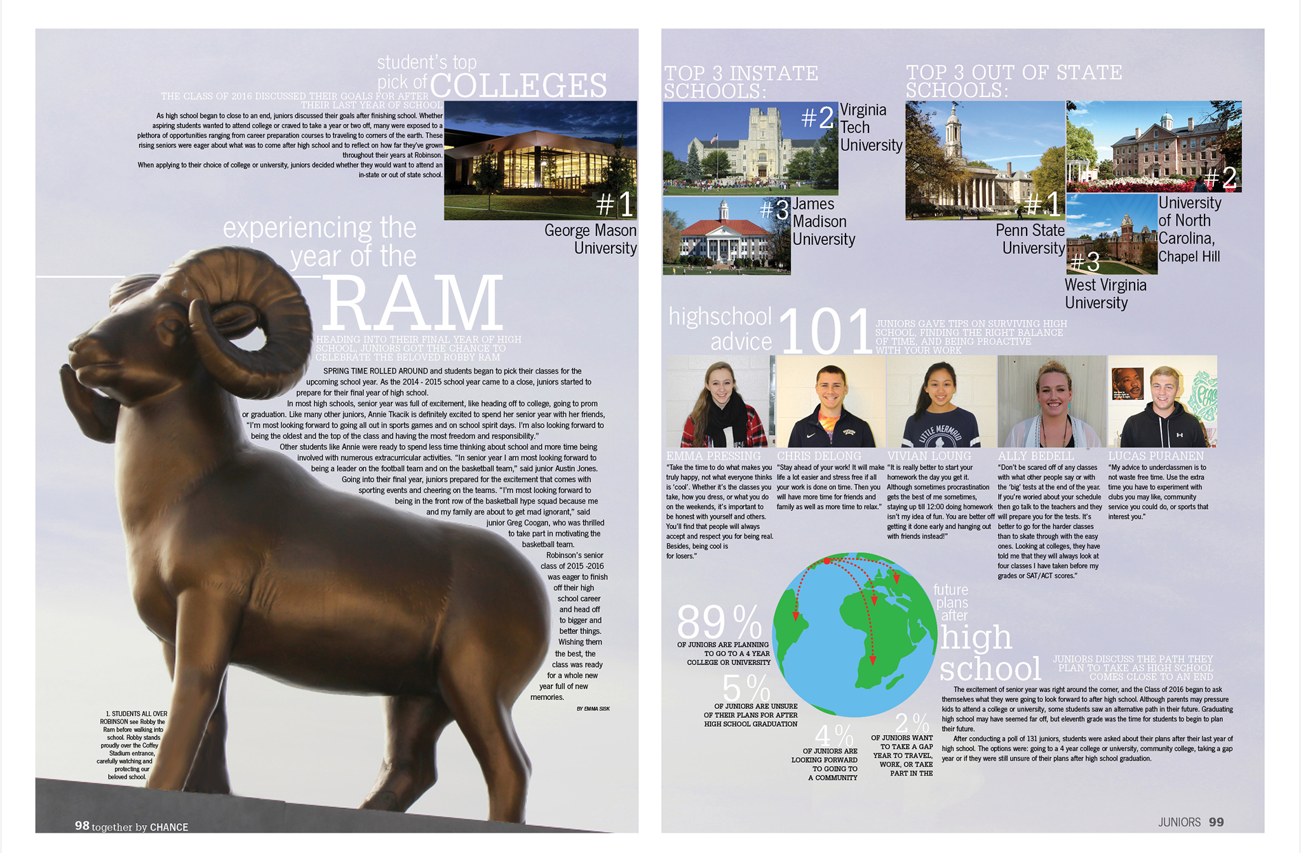
Bottom right: Poll on juniors after graduation plans

Slide 49
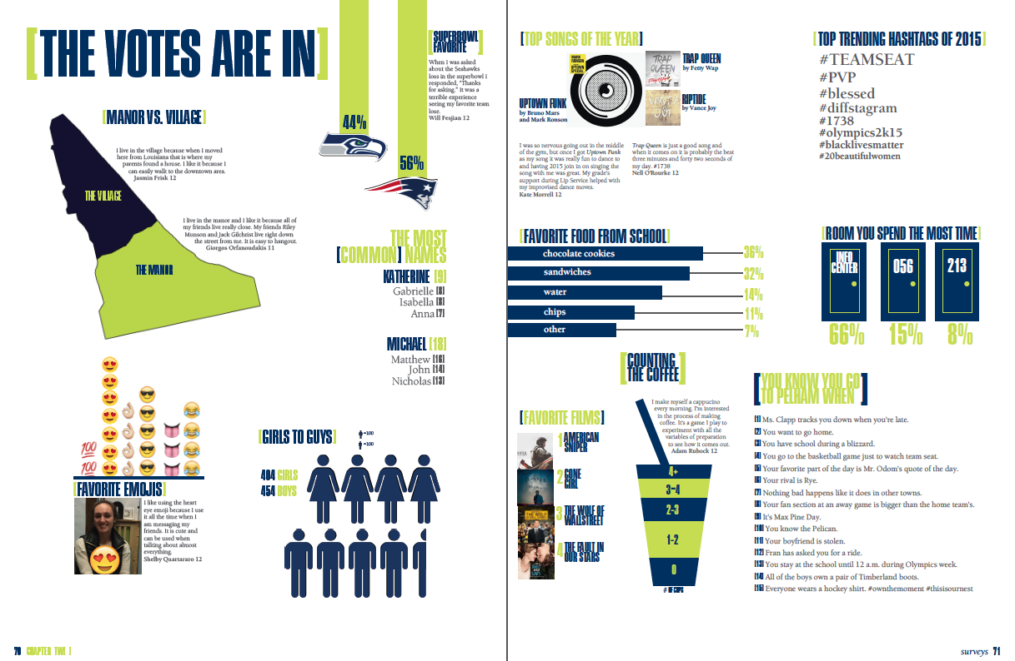
Various charts/infographics give the reader a variety of information.

Slide 50
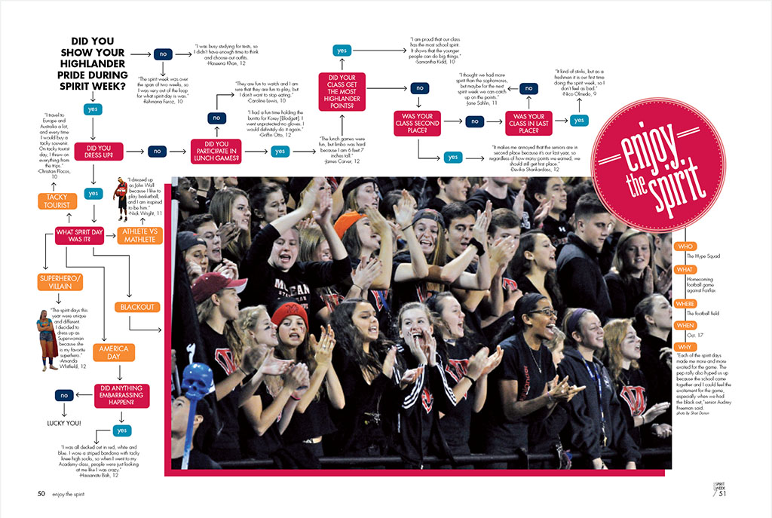
This diachart directs the reader to show the degree of school spirit during spirit week.

Slide 51
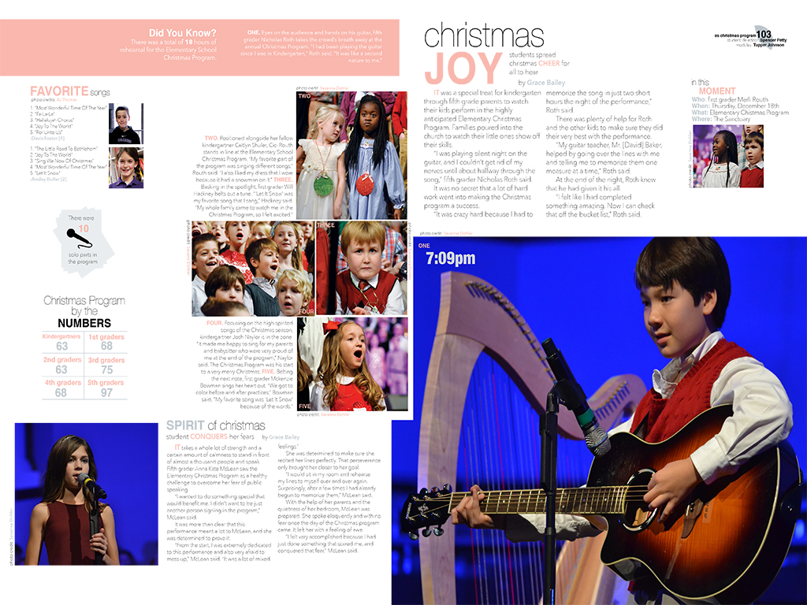
Middle left (with microphone): Information about solo performances in the concert.

Slide 52
Middle : Information about the new gym floor using color, numbers, and pics

Slide 53
Fact Box
Fact vs. Fiction
Stats
Numbers
Roundtable
Q & A
Breakdown
Chart
Do’s and Don’ts
Recipe
How to
Tag the Date
Rating
Pros & Cons
Tweets
Matching
Past vs. Present
Specialty Sports

Slide 54
Countdown to nine facts about the principal
- provided by Erinn Harris and Meghan Percival

Slide 55
10 ways to stay cool during summer.

Slide 56
Statistics on sleep and different classes – provided by Erinn Harris and Meghan Percival

Slide 57
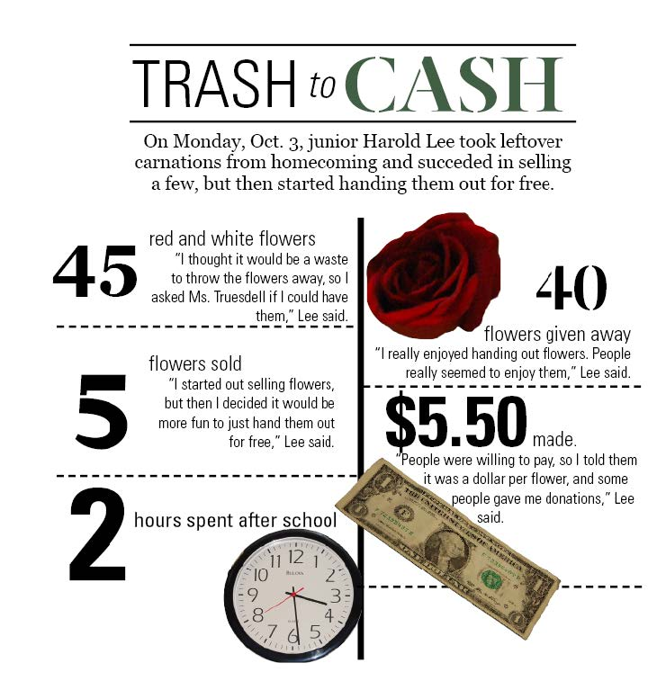
Tell a story by using numbers– provided by Erinn Harris and Meghan Percival

Slide 58
Several faculty members tell about the school through the years with questions throughout.
– provided by Erinn Harris and Meghan Percival

Slide 59
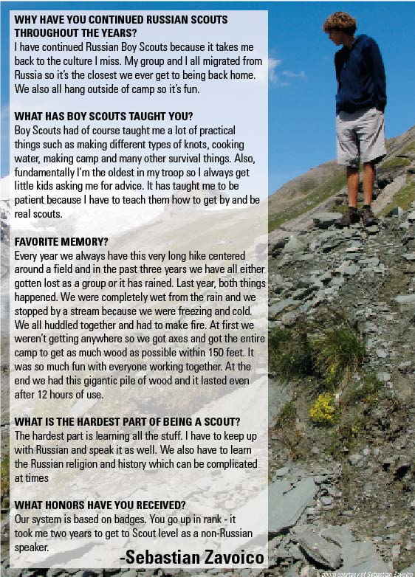
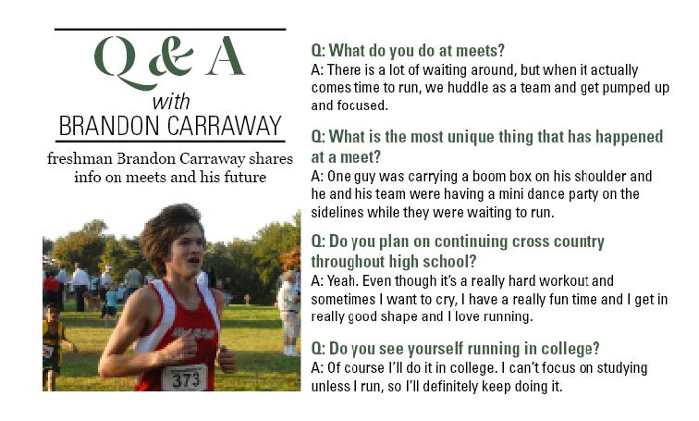
Question and Answer with one person – provided by Erinn Harris and Meghan Percival

Slide 60
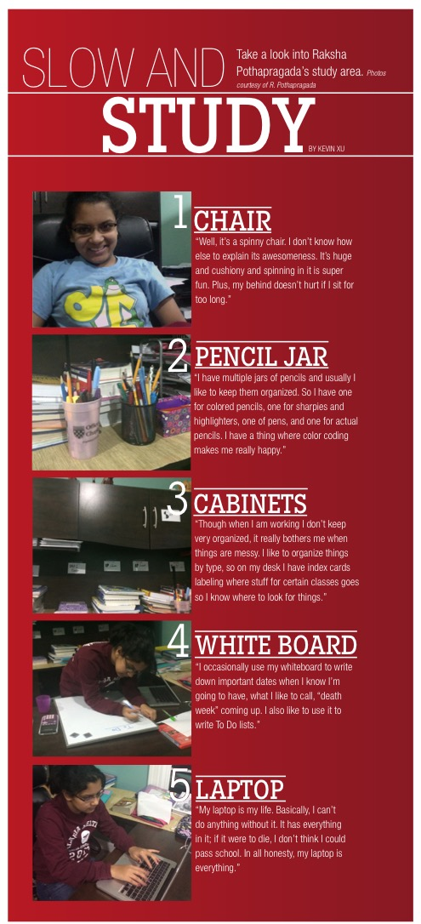
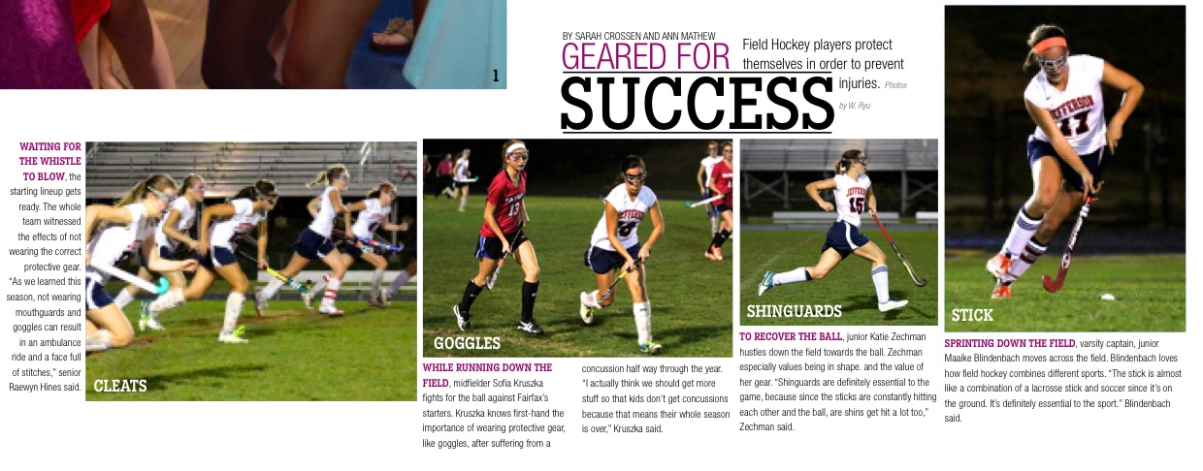
Breakdown of the items in a students study area and what is needed to play a sport
– provided by Erinn Harris and Meghan Percival

Slide 61
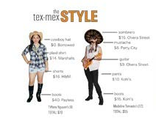
Breakdown of the cost to play a sport or participate in an activity
– provided by Erinn Harris and Meghan Percival

Slide 62
Do’s and don’ts of taking a great picture: school picture day
– provided by Erinn Harris and Meghan Percival

Slide 63
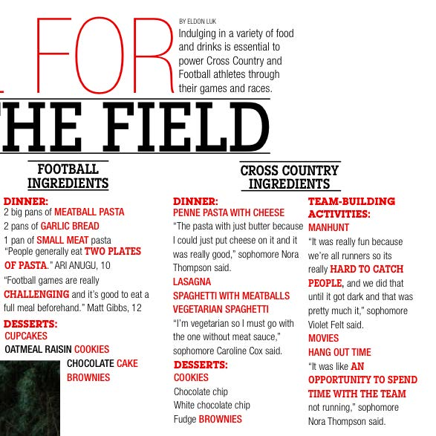
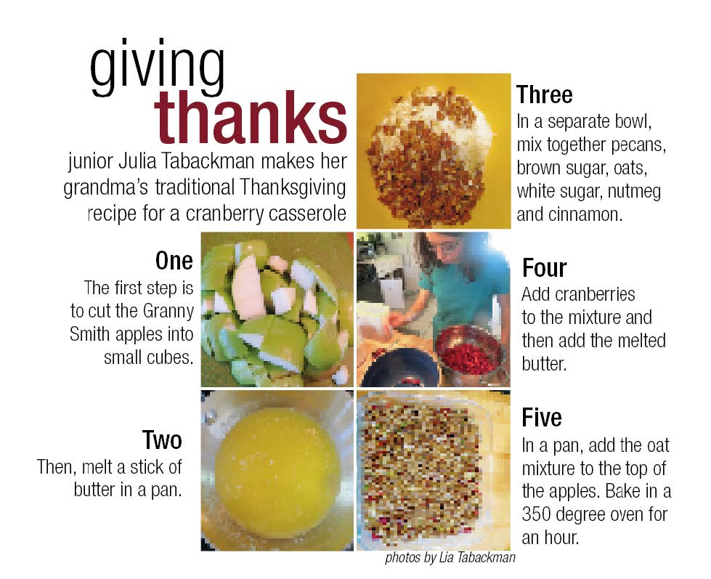
Recipes for a great Thanksgiving and playing sports
– provided by Erinn Harris and Meghan Percival

Slide 64
How to create the unique style of this student.
– provided by Erinn Harris and Meghan Percival

Slide 65
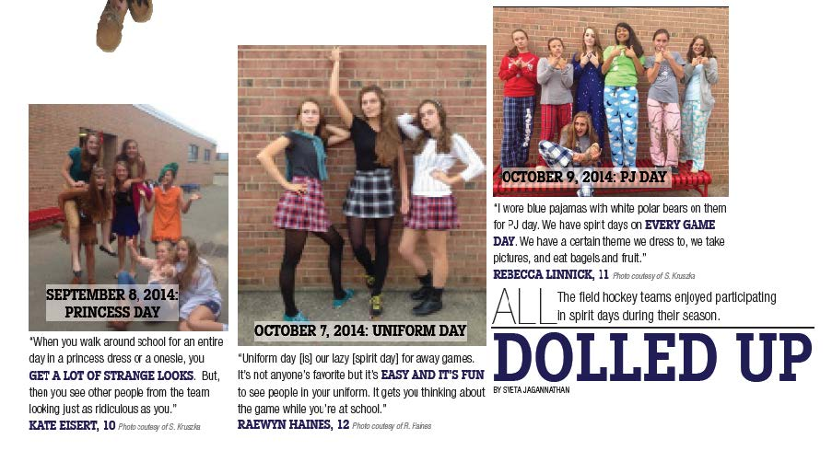
Show the progression of a topic by tagging the day.
– provided by Erinn Harris and Meghan Percival

Slide 66
Rate an event, food or assignment on a scale of 1-5
– provided by Erinn Harris and Meghan Percival

Slide 67
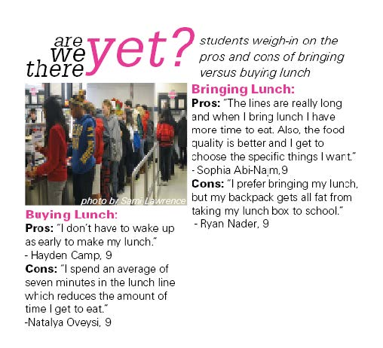
Pros and Cons of buying lunch or bringing lunch
– provided by Erinn Harris and Meghan Percival

Slide 68
Take an issue or topic and provide tweets from students.
– provided by Erinn Harris and Meghan Percival

Slide 69
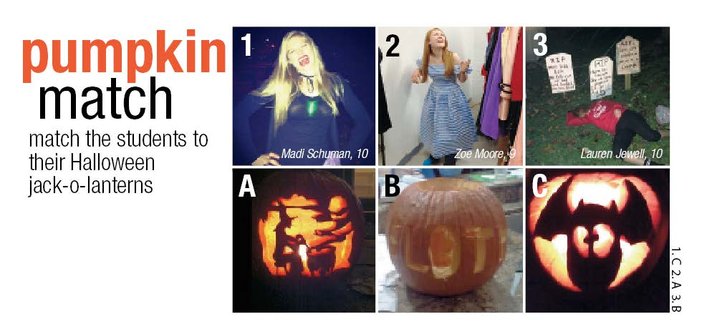
Match the student to their pumpkin. Don’t forget to provide the answer.
– provided by Erinn Harris and Meghan Percival

Slide 70
Compare the past with the present. Use questions and facts.

Slide 71
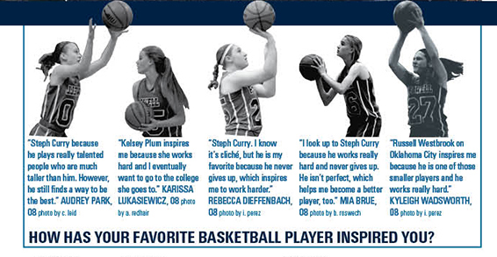
Especially if a season isn’t a success, find questions to ask that highlight all members on the team.

