Slide 3
Understanding hierarchy
The largest, dominant photo should be the most important and best quality.
As we make other photos and design elements smaller, we are assigning importance to those items.
The smallest items should be the least important.
A variety of photo sizes keeps the eye moving across the spread.

Slide 4
Secondary coverage mod
Second level of coverage. Smaller in text and photo size than a level-one mod.

Slide 5
Picture package mod
A group of photos, starting with one dominant photo and others getting smaller in size, all sharing a side with the dominant.

Slide 6
Primary copy mod
First level of coverage. Usually the most important story or topic of the spread with the largest headline. Also labeled level-one copy or dominant copy.

Slide 7
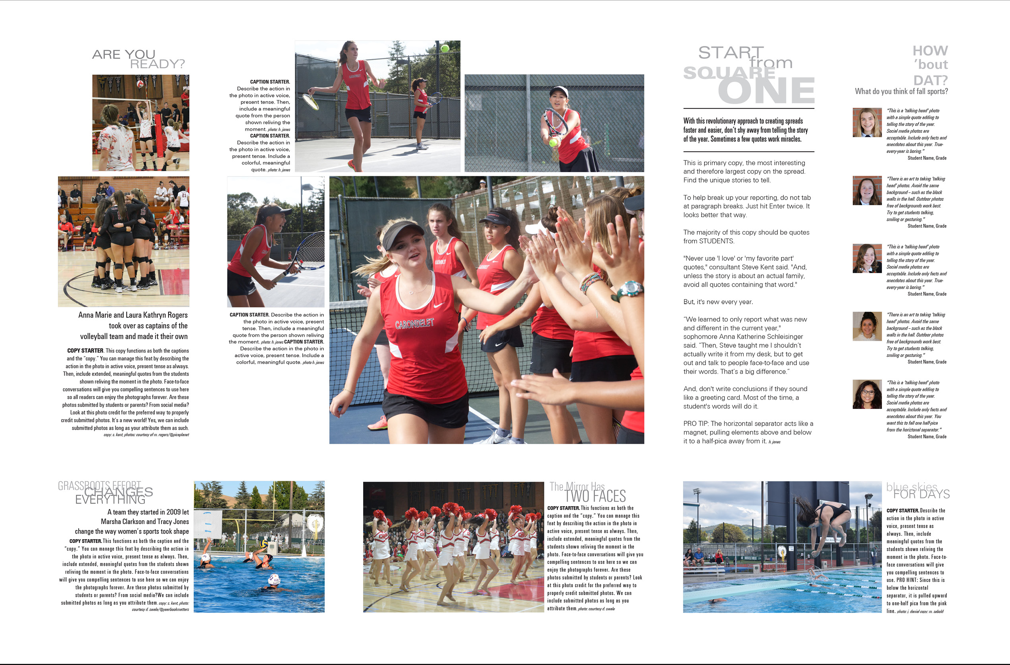
Supplementary coverage mod
Any small level of coverage used to get more students in the book.

Slide 8
Folio
Spread identifier including page number. Usually placed in the external margin. Label all content on the spread here.

Slide 9
Tertiary coverage mods
Third level of coverage. Smaller in text and photo size than a level-two mod, but always readable.

Slide 10
Understanding modular design
The case for modular design
Coverage broken into modular pieces, or mods, on a spread.
Breaking a spread into mods of different sizes creates many levels of coverage. This helps a staff include more students in the yearbook.
Allows for any combination of pre-designed, interchangeable mods to format pages on a grid. Think of it like pieces of a puzzle fitting together.

Slide 11
Defining Square OneTM
A non-printing grid — called a Swiss grid by professional designers — of same-sized squares is the basis for page layout.
What separates the Swiss grid approach from traditional pagination is the use of squares larger than one pica as the unit of measure.
This makes alignment and margins easy to follow.

Slide 12
Defining Square OneTM
Exclusive to Herff Jones, Square OneTM uses half a pica of inner spacing between each 3 x 3-pica square.
It’s consistent across all three trim sizes and provided for both eDesign and InDesign users.
Refer to the Covering your School section to understand how committing to Zero Zeros will help make Square OneTM work for you.

Slide 13
Mauldin High School / Mauldin, SC

Slide 14
Darlington School / Rome, GA

Slide 15
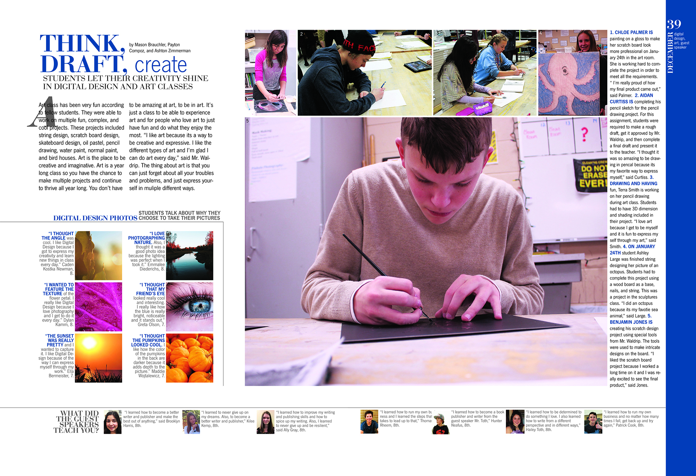
Sierra Middle School / Parker, CO

Slide 16
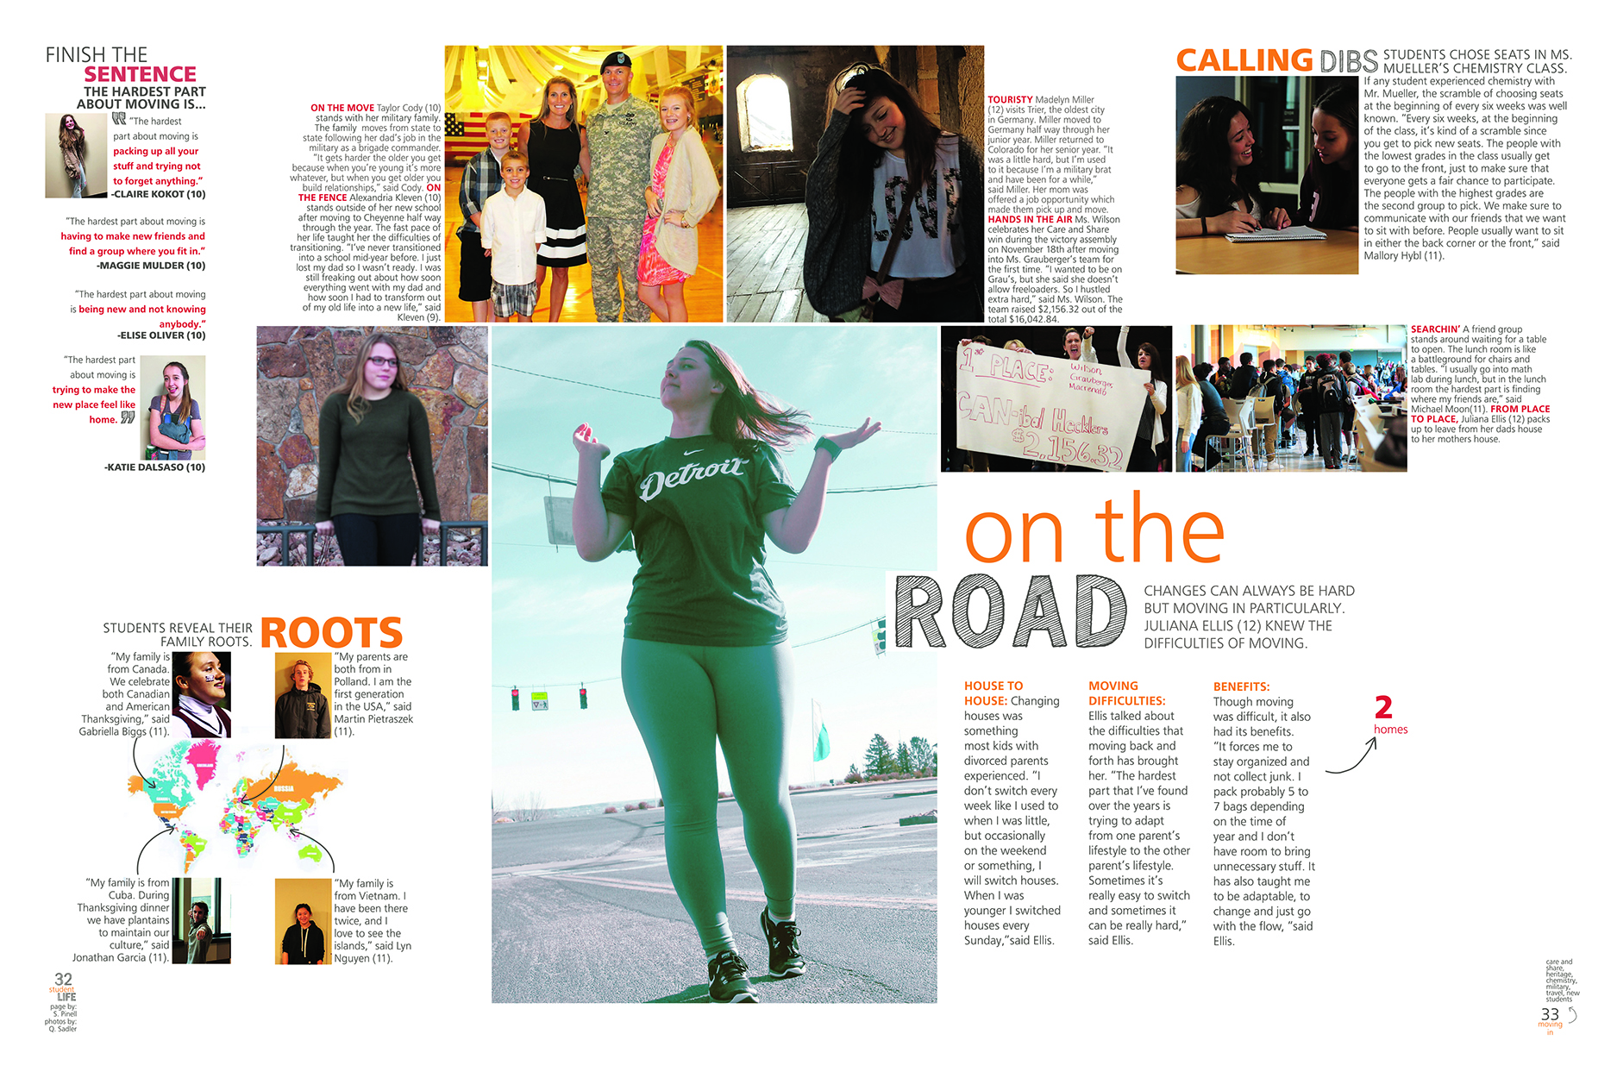
Cheyenne Mtn High School / Colorado Springs, CO

Slide 17
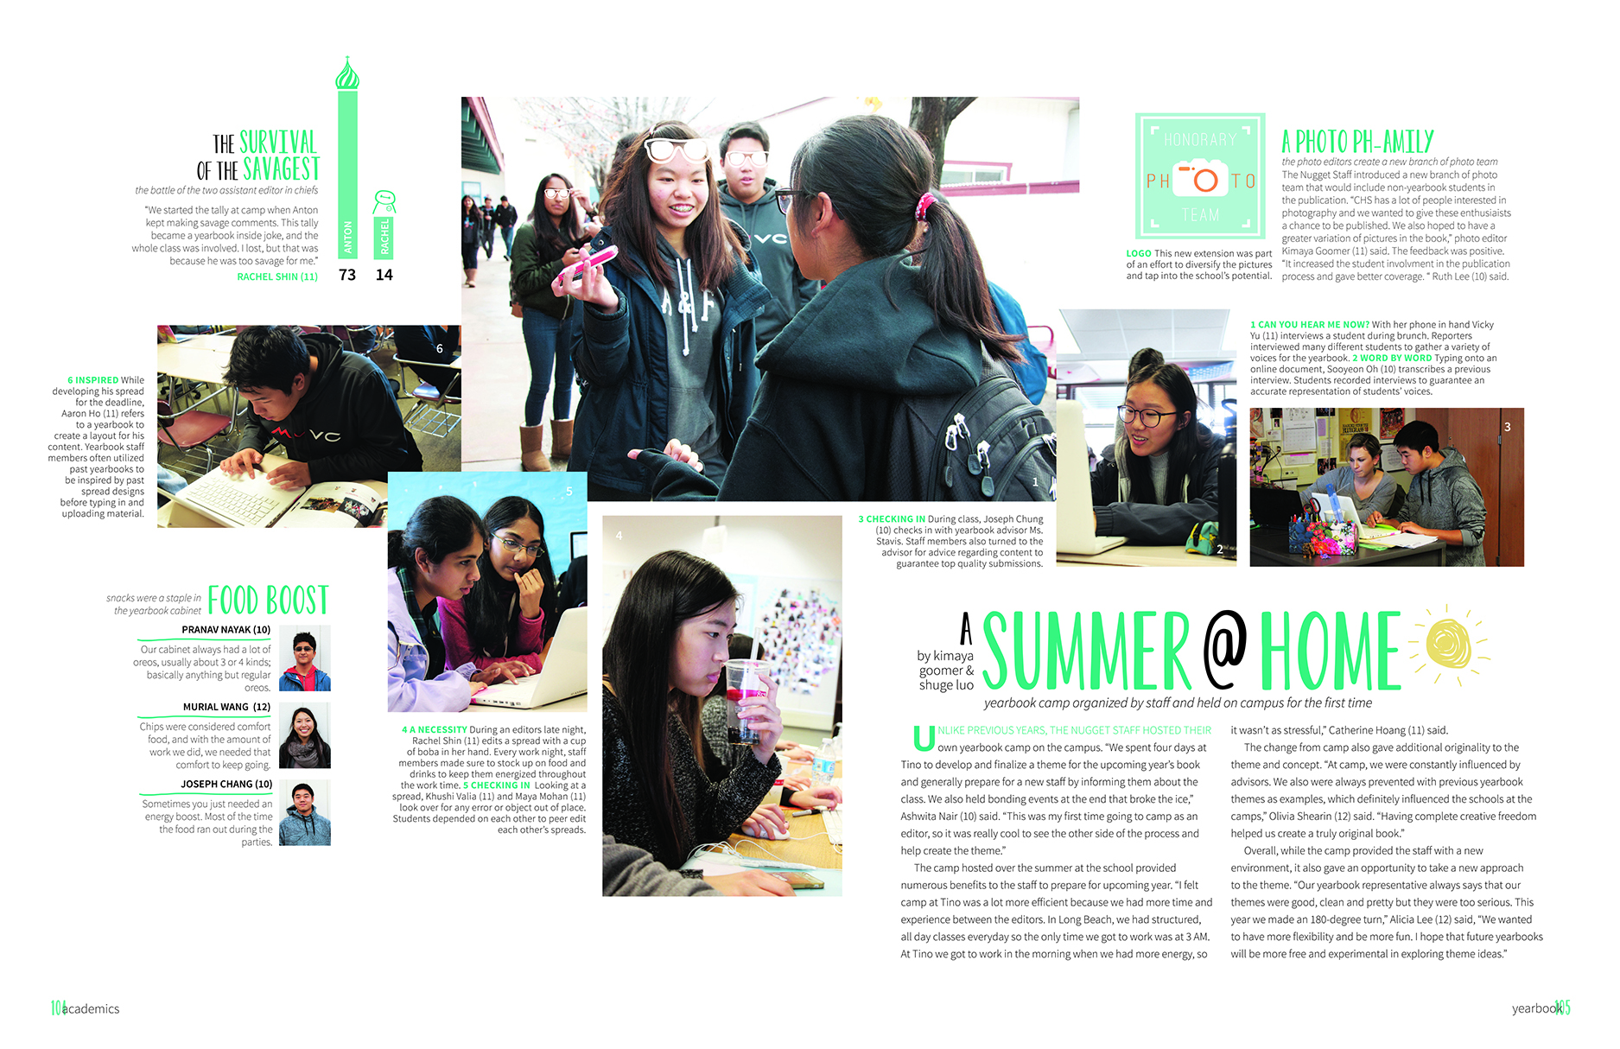
Cupertino High School / Cupertino, CA

Slide 18
Lewis-Palmer High School / Monument, CO

Slide 19
Know the grid
Grid
This is a hidden layer on a document of same-sized squares. It helps create structure on which to build mods, but does not print.
This is the live area of a spread for content to be contained.
White space
Also known as negative space, is any area on a spread not taken up by content or graphics. It can make your visual message stronger and help navigate readers through a spread.

Slide 20
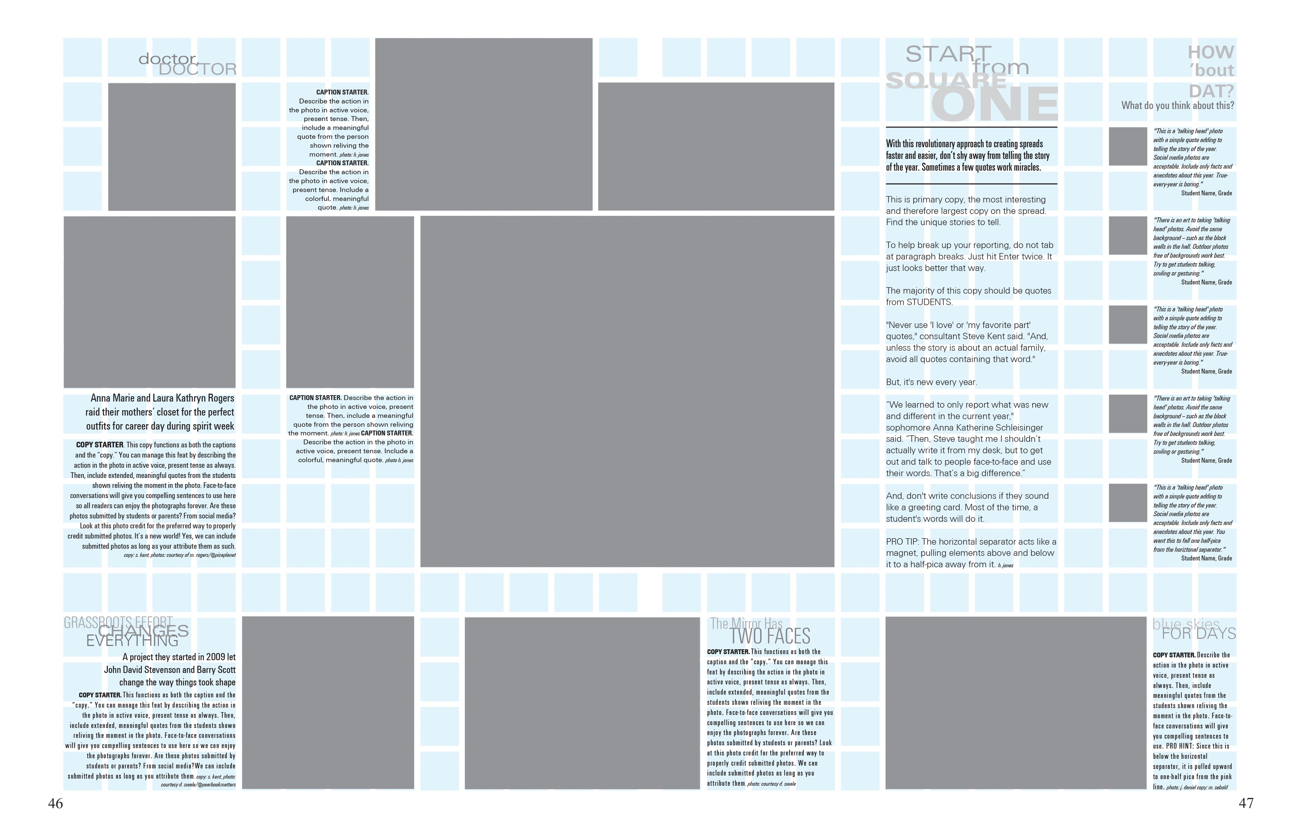
White space
Also known as negative space, is any area on a spread not taken up by content or graphics.

Slide 21
Know the grid
Inner spacing
Half a pica of space between photos and copy indicates to readers these items are meant to be consumed together as one package.

Slide 22
Inner spacing
1/2 pica space between pieces of a mod.

Slide 23
Know the grid
Internal margins, separators
Internal margins, formerly called rails, provide consistent spacing between all coverage packages on a spread.
We use pink to represent a “separator” in this space to make it stand out as distinct borders for mods when building a spread, but they are not part of the design that prints.
Once you build a spread, delete the pink separators. The remaining internal margin helps indicate to readers when an element should be considered separate from other content.
Separators are the size of one square on the grid and can be extended horizontally or vertically across a spread.

Slide 24
Separators
Markers of internal margins, which provide consistent spacing between all elements on a spread.

Slide 25
Know the grid
External margins
White space around the border of a spread. All layouts should have a consistent external margin and, while the top and side margins in the book are the same, the bottom margin is usually 2 to 4 picas taller.
Coverage does not typically extend into the external margin unless it is designed to bleed off the page for emphasis.
Bleed
When an element on the spread extends off the grid and goes all the way to the edge of the page. This can be used for color, graphics, dominant photos, etc. Copy should not bleed.

Slide 26
External margins
White space around the spread.

Slide 27
Understanding design principles
Understanding the design principles will help you make calculated decisions. There should be a reason for every decision made.
Simply decorating with graphics is not a function of design. If used at all, graphics should work together to connect, divide, direct or emphasize elements without overpowering them.
Good design pulls readers into a spread and connects a book to the year through its theme and voice.

Slide 28
Understanding design principles
Voice
You must decide on what you want the overall feel or personality of the book to be, known as the voice.
The voice will affect every design decision you make for the book, such as fonts, colors, graphics, etc.
This does not mean everything will look the same, use variations so readers don’t get bored.
But don’t get crazy. Variety is good, but limit the look so it stays as one visual voice.

Slide 29
Troy High School / Troy, Michigan

Slide 30
Troy High School / Troy, Michigan

Slide 31
Understanding design principles
Proximity/packaging
Group related items together.
If an item is close in proximity to another, it is expected they should be viewed as a whole package.
Creating one visual unit of related items helps organize your spread and reduces unclear clutter.

Slide 32
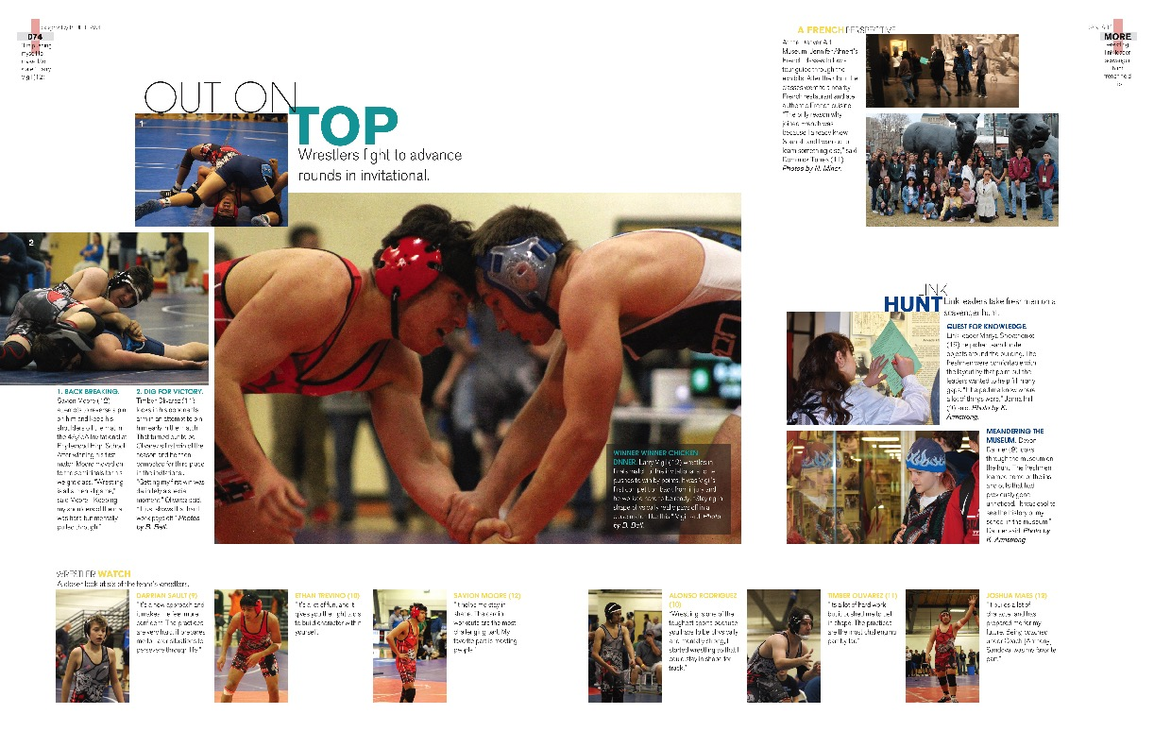
Arvada High School / Arvada, CO

Slide 33
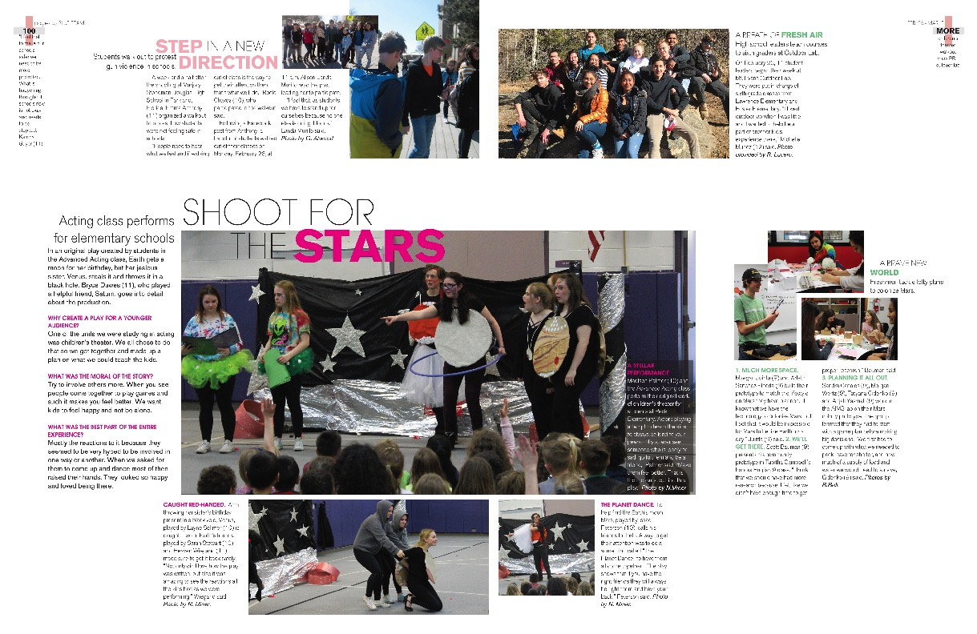
Arvada High School / Arvada, CO

Slide 34
Understanding design principles
Readability/navigation
Design choices should make content easy to read and follow.
When making font selections and placing graphics, always take readability into consideration.
Readers should know immediately what you’re trying to communicate. This is achieved by having dominant elements of importance, like you learned with levels of coverage. Any design choices should only help advance that hierarchy, not clutter a page or make it hard to follow.

Slide 35
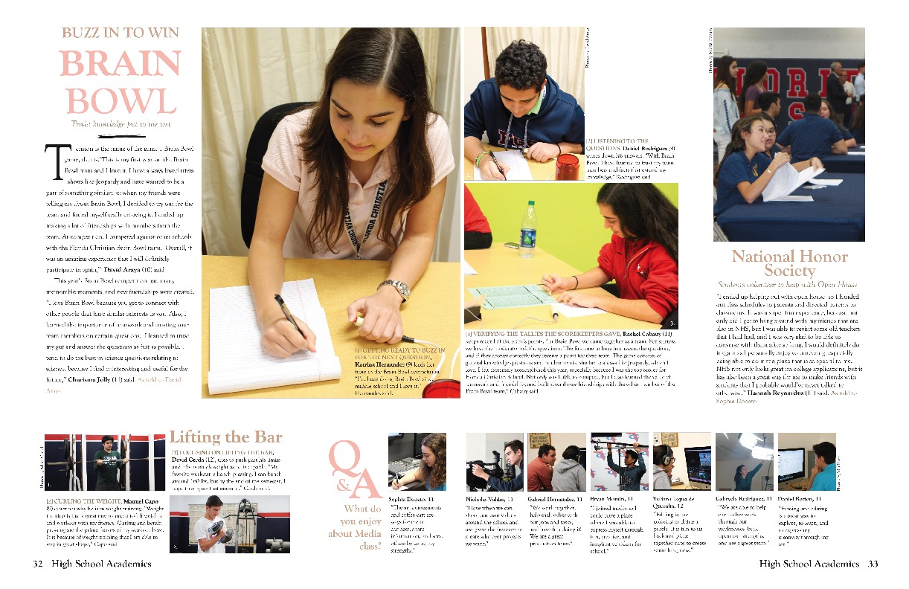
Florida Christian School / Miami, FL

Slide 36
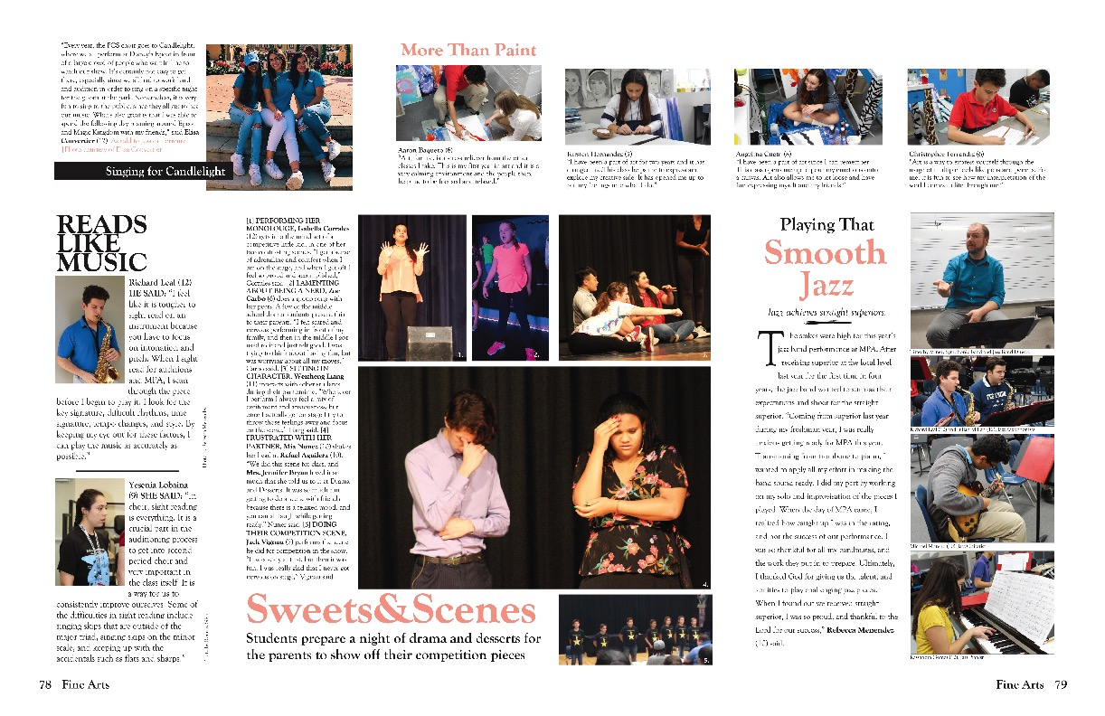
Florida Christian School / Miami, FL

Slide 37
Understanding design principles
Repetition
Repeat visual elements throughout your publication.
Elements do not have to be the exact same on pages to achieve this. Designers create visual variety with a mix of consistent components.
Create links between elements with consistent use of type, white space and graphics.
Repeating elements develops an organization and unity throughout.

Slide 38
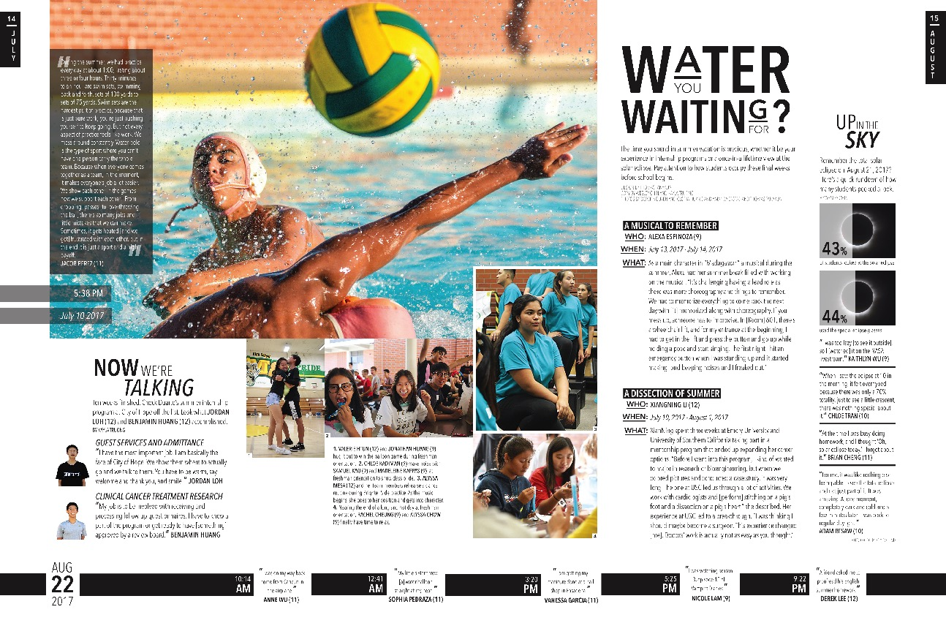
Temple City High School / Temple City, CA

Slide 39
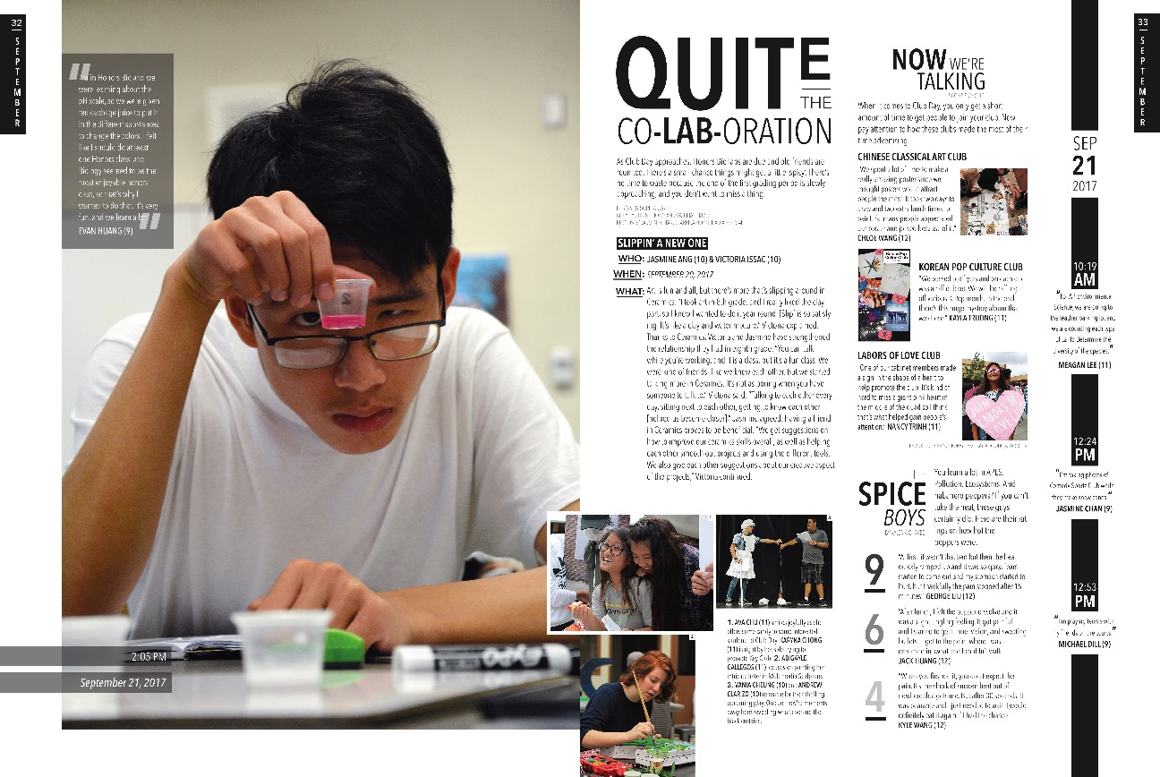
Temple City High School / Temple City, CA

Slide 40
Understanding design principles
Alignment
Nothing is placed arbitrarily.
Aligning elements to something else on a spread provides a visual connection, and helps the reader navigate the spread.

Slide 41
Texas High School / Texarkana, TX

Slide 42
Texas High School / Texarkana, TX

Slide 43
Understanding design principles
Contrast
If items are not exactly the same, make them drastically different. There should be no confusion for the reader if fonts are the same style, pictures are the same size, colors are the same shade, etc.
Contrast helps with the hierarchy of a spread by emphasizing elements you want to stand out.
Contrast is what catches readers’ attention in the first place.

Slide 44
Tuscarora High School / Leesburg, VA

Slide 45
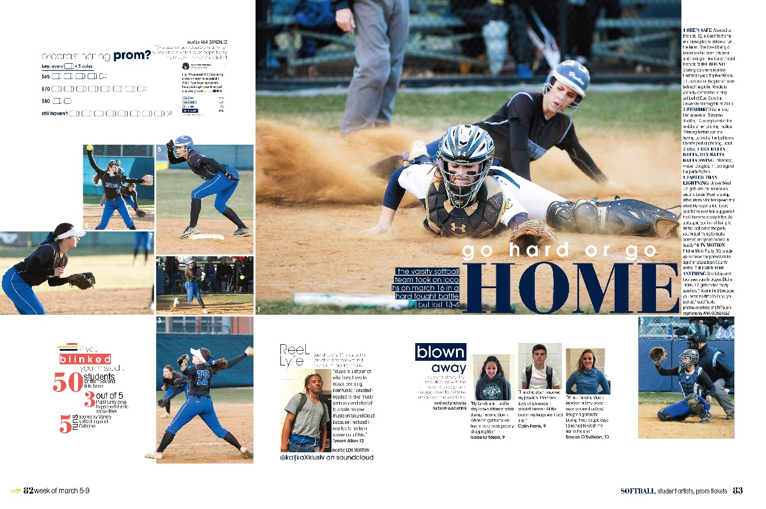
Tuscarora High School / Leesburg, VA

Slide 46
Understanding Design Principles
Balance
Do not cluster all your best design styles or elements to one area, distribute elements across the spread to achieve balance.
This is more aesthetically pleasing to readers, rather than having one area of heavy design.

Slide 47
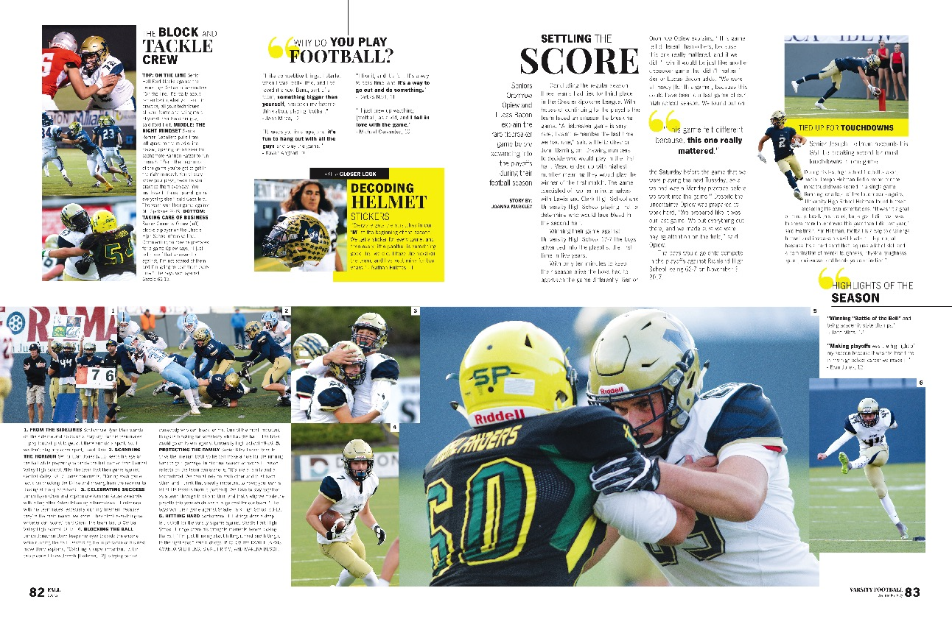
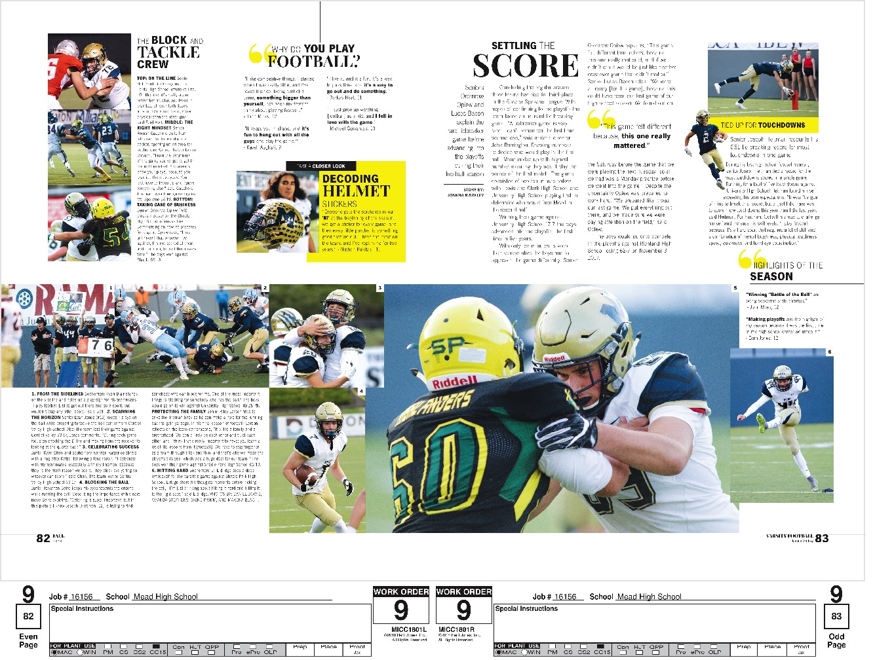
Meade High School / Spokane, WA

Slide 48
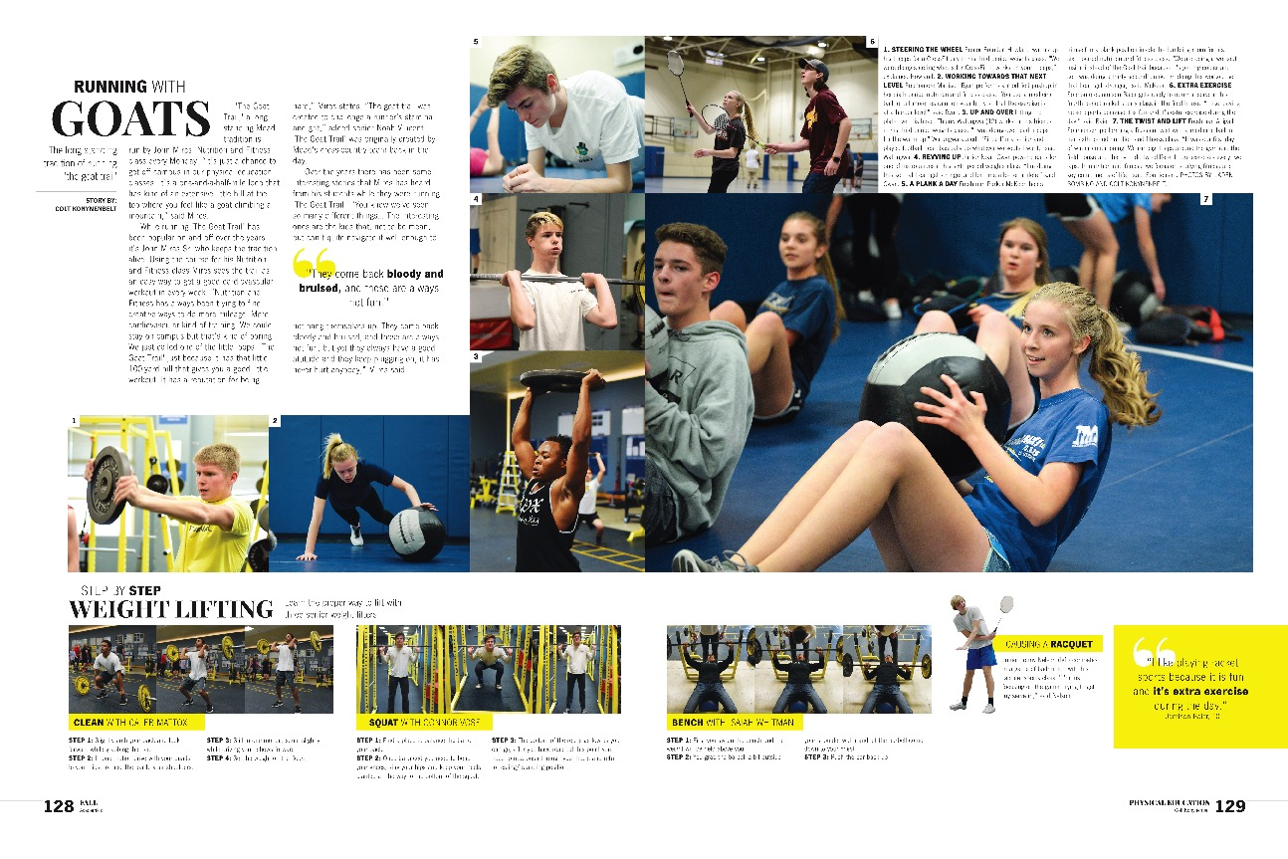
Meade High School / Spokane, WA

