Slide 1
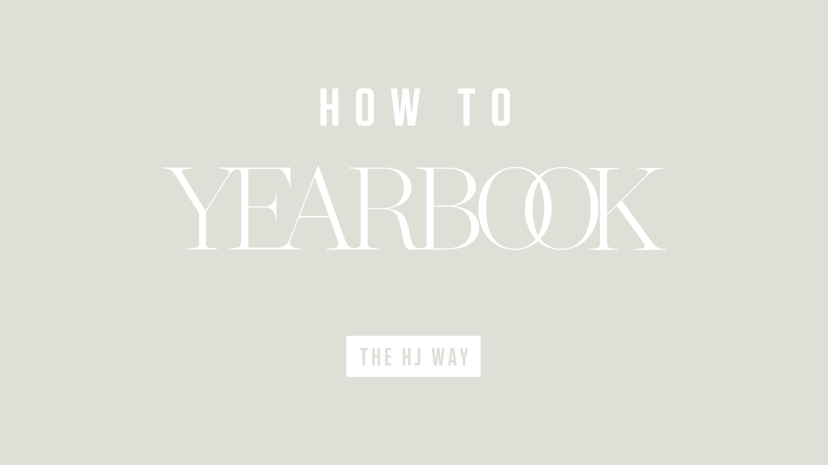

Slide 2


Slide 3
Understanding reporting
Remember, an interview is just a conversation and most people love to talk about themselves.
Allow them to do so.
Listen.

Slide 4
Understanding reporting
Pre-angle
Start with some clue of where you want the story to go. Approach the subjects in your story with something. You will need to research. Talk to your friends and peers and ask questions.
Pre-interviews
Interview people about potential angles for your story. Your job is to find out what is really happening. Don’t write a story about your friends, but talk to your friends to find a story.

Slide 5
Understanding reporting
Access
Contact whoever is in charge of your topic.
Let them know what you were doing and when you need to be in a certain place. Ask permission. Then, ask about potential angles.
Be courteous and professional. Clear communication is one of the keys to your story.
Observation
Observe your subjects in action. You never know which moment will
become your lead.

Slide 6
Understanding reporting
Interview prep
Prepare questions ahead of time. Type them. Study them. Because you’ve observed the subject, you will be able to ask specific questions.
Angle
At this point in the process, you should have a clear understanding of where you are headed. It may change during your interview if a new topic arises.

Slide 7
Understanding reporting
Interviews/new angle
Remember all the tips you’ve learned in your class, and remember,
if you come up with a better angle during the interview, it’s
OK to change.
Conduct the interview like a conversation.
Lead
While your interviews are still fresh in your mind, review your notes and write your lead.

Slide 8
Understanding reporting
Organization
Before proceeding, set up an organization process.
Organize notes from various interviews. Put relevant quotes together.
If you recorded your interviews, transcribe your notes.
How will the story flow? Will you include every source you interviewed? Which quotes will you summarize?
Do what it takes to add logical organization to your story.

Slide 9
Understanding reporting
More interviews
It is OK to call an interviewee to ask more questions, clarify answers and check facts. Make sure you have a way to contact them.
Write and edit the story
Sit down. Take the time to write thoughtful copy.
There is no excuse for turning in copy with spelling, grammatical and style errors. Use your resources and spell check, but remember, it doesn’t catch everything.

Slide 10
For starters
Consider group interviews.
When more people are together, everyone relaxes.
Team up reporters and gather small groups of two or
three interviewees.

Slide 11
Understanding interviews
You can’t write a good story without talking to people.
Find sources, listen to them, allow them to tell their stories and ask follow-up questions until you have your story.
Follow the tips on the following slides!

Slide 12
Steps to make an interview work
Prepare
Journalists must know what they need to ask before the interview. Talk to other students, coaches and teachers. Write those questions down.
Ask open-ended questions
These begin with “How” “What” “Where” “When” and “Why.” They start conversations which lead to the information you want. And don’t ask two questions at once. Make them answer the tough question before moving on.

Slide 13
Steps to make an interview work
Be quiet
If you stop talking, they’ll start. Smile and nod. Don’t interrupt. Let silence linger longer than a normal conversation. They will keep talking.
Care
If you show your subject you think their story is important,
they are more likely to open up to you

Slide 14
Steps to make an interview work
Keep them in the know
Tell your interviewee what you’re writing about (in general). They might help you stay on topic.
Edit
Revision is not just for the finished product. They should only be as long as they are relevant. Keep only necessary words in the necessary quotes.

Slide 15
Record, reflect and repeat
Record a “big story” interview and a series of quick interviews.
Listen and take notes. What did you do right? Wrong? Did you interrupt the interviewee? Did you ask close-ended questions? Did you let them skip a tough question?
Learn from your mistakes. Write reminders in your notebook.
You’ll be a better reporter.

Slide 16
Remember
Sitting in the yearbook room, writing a story without doing any research or interviewing anyone is not reporting.
Asking someone to “give you a quote” is not reporting.
Put in the work and you’ll get the story.

Slide 17


